Slide 1

Deep Learning for Search (a.k.a. “Neural Information Retrieval”)
Eran Fainman
Machine Learning Engineer, Alexa Shopping, Amazon, IL
eranfa@amazon.com

Slide 2
About Myself
Machine Learning Engineer, Alexa Shopping, Amazon
Team Leader, Echo team, 8200
Developer, NLP team, 8200
Information Systems Engineering, MSc, Ben-Gurion University
Industrial Engineering, BSc, Tel-Aviv University

Slide 3
Neural Information Retrieval
The lecture is based on Bhaskar Mitra (Microsoft) slides:
https://www.slideshare.net/BhaskarMitra3/deep-learning-for-search-204326329
“An introduction to Neural Information Retrieval” book:
https://www.microsoft.com/en-us/research/publication/introduction-neural-information-retrieval/
TREC deep learning track:
https://microsoft.github.io/TREC-2019-Deep-Learning/

Slide 4
Agenda
Time | Topic
9:00-9:10 | The Search Task
9:10-9:30 | Learning to Rank
9:30-10:30 | Embeddings
10:30-10:40 | Break
10:40-11:15 | Shallow Neural Methods for Ranking
11:15-12:15 | Lunch
12:15-13:45 | Deep Neural Methods for Ranking
13:45-14:00 | Break
14:00-15:00 | Skip-gram Exercise
15:00-16:00 | CBOW Exercise

Slide 5
The Search Task
Time | Topic
9:00-9:10 | The Search Task
9:10-9:30 | Learning to Rank
9:30-10:30 | Embeddings
10:30-10:40 | Break
10:40-11:15 | Shallow Neural Methods for Ranking
11:15-12:15 | Lunch
12:15-13:45 | Deep Neural Methods for Ranking
13:45-14:00 | Break
14:00-15:00 | Skip-gram Exercise
15:00-16:00 | CBOW Exercise

Slide 6

Information Retrieval (IR)
User has an information need
There exists a collection of information resources
IR is the activity of retrieving the information resources relevant to the information need

Slide 7

Example of an IR Task
Amazon Catalog

Slide 8
IR Basic Elements
Term frequency
Term weighting
Term saturation
Document length
Term proximity
Term position
Vocabulary mismatch
Term aboutness

Slide 9
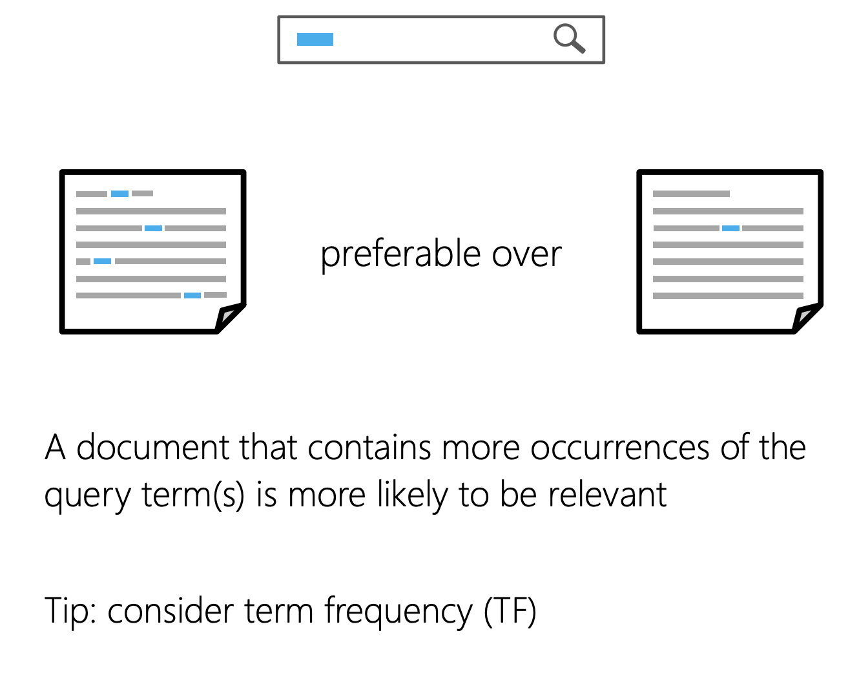
IR Basic Elements
Term frequency
Term weighting
Term saturation
Document length
Term proximity
Term position
Vocabulary mismatch
Term aboutness

Slide 10
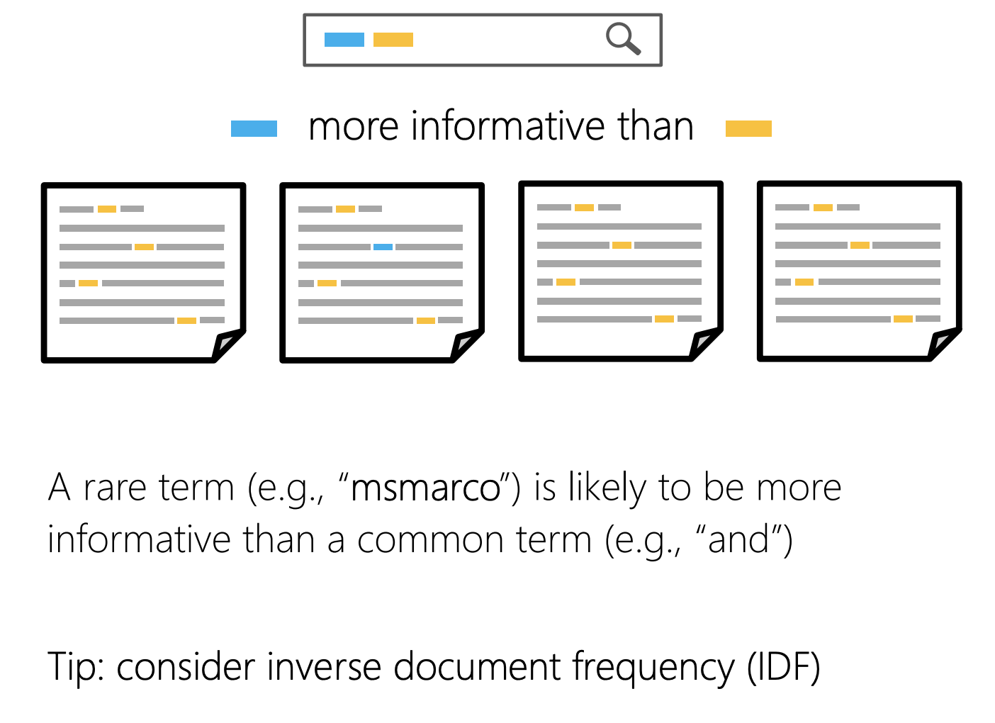
IR Basic Elements
Term frequency
Term weighting
Term saturation
Document length
Term proximity
Term position
Vocabulary mismatch
Term aboutness

Slide 11
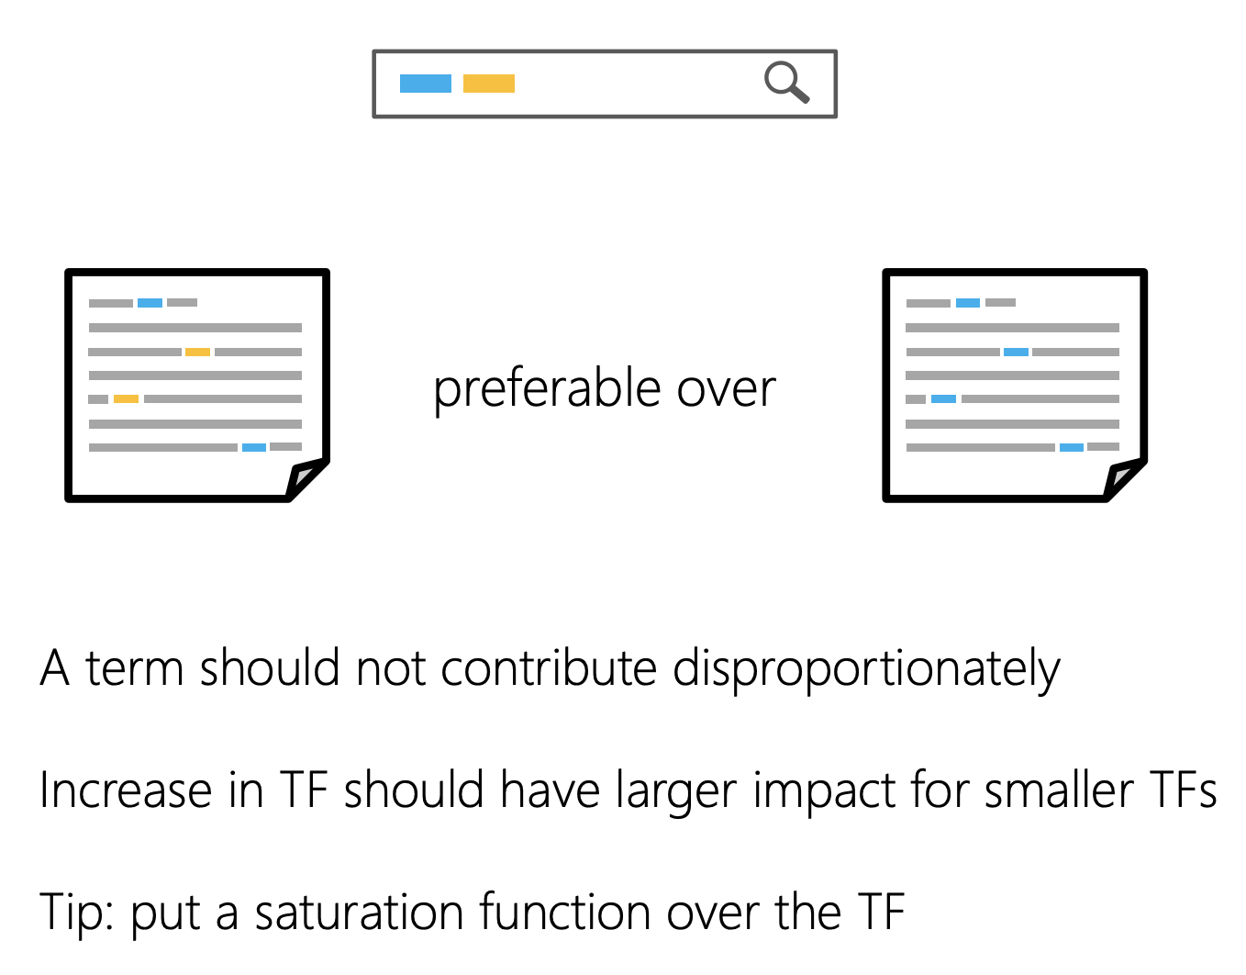
IR Basic Elements
Term frequency
Term weighting
Term saturation
Document length
Term proximity
Term position
Vocabulary mismatch
Term aboutness

Slide 12
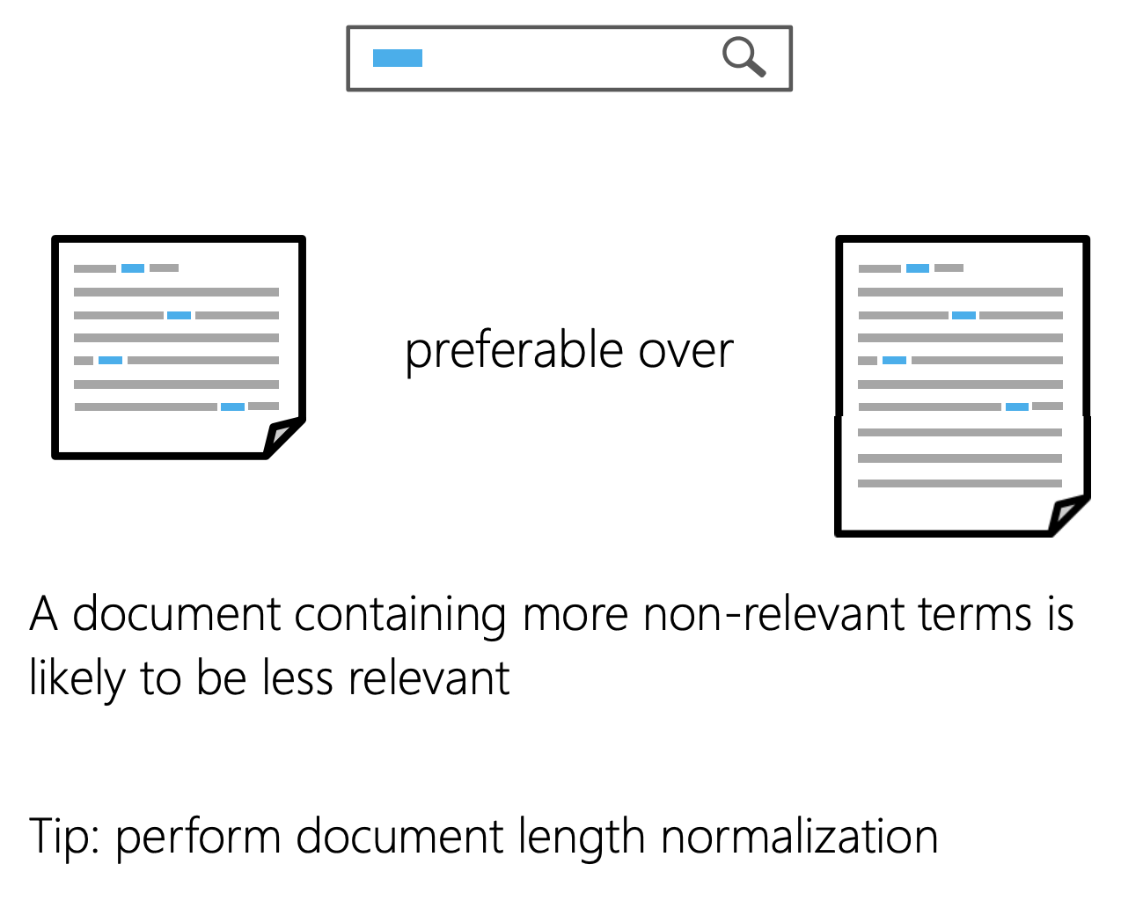
IR Basic Elements
Term frequency
Term weighting
Term saturation
Document length
Term proximity
Term position
Vocabulary mismatch
Term aboutness

Slide 13
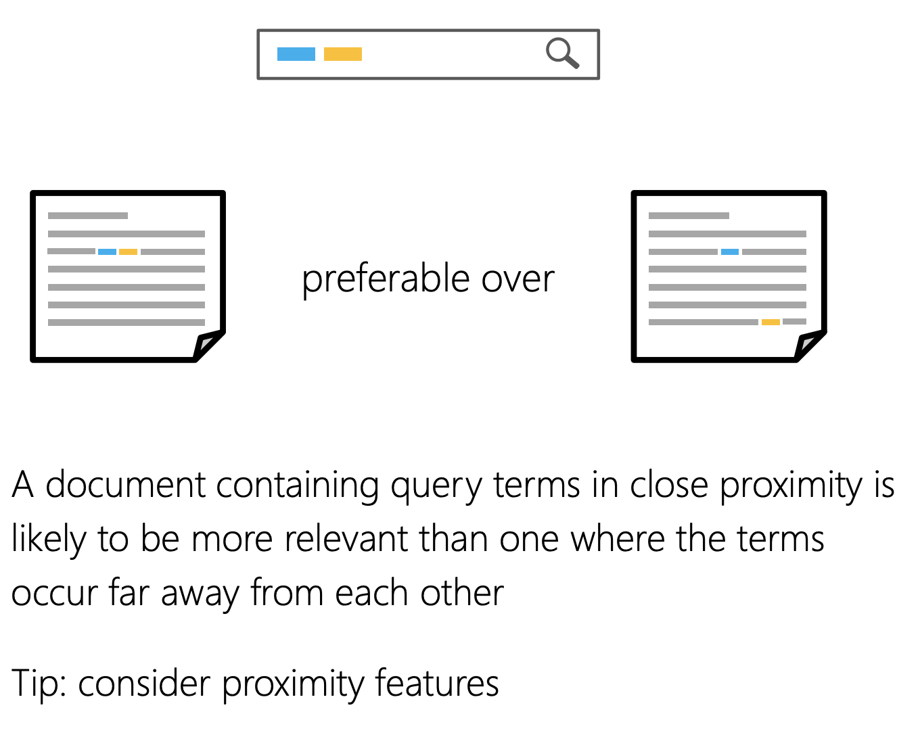
IR Basic Elements
Term frequency
Term weighting
Term saturation
Document length
Term proximity
Term position
Vocabulary mismatch
Term aboutness

Slide 14
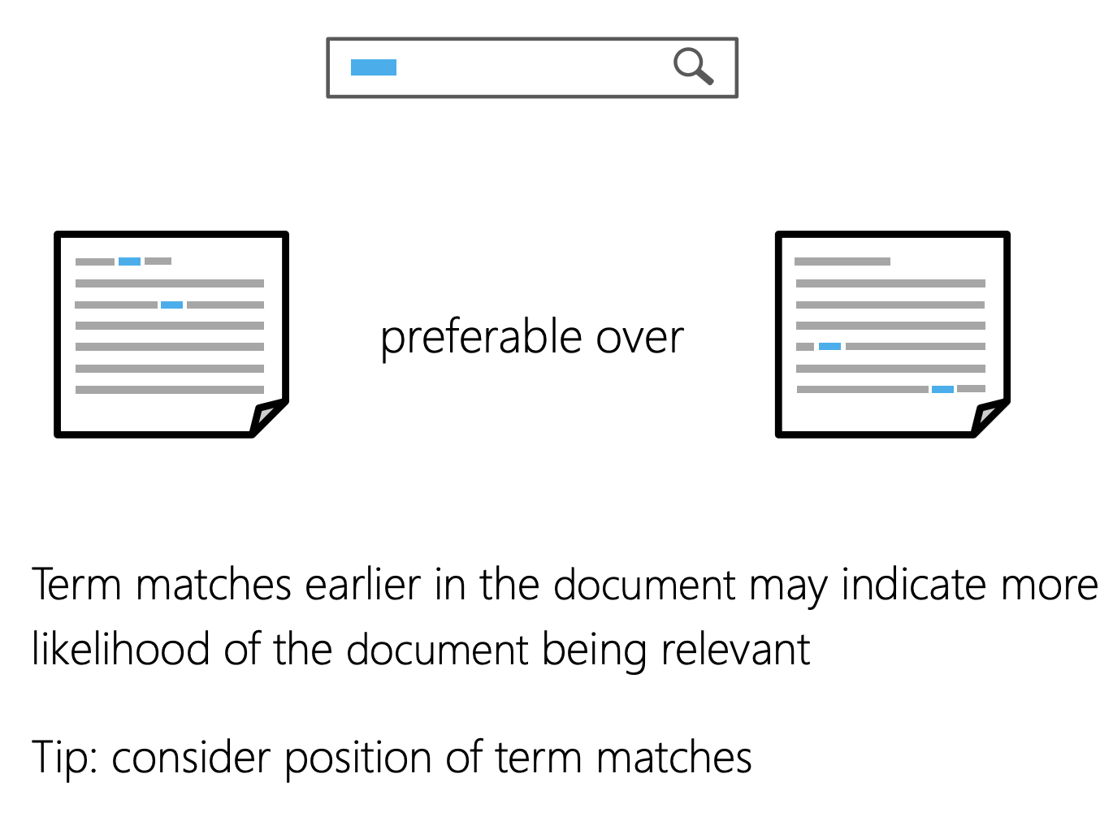
IR Basic Elements
Term frequency
Term weighting
Term saturation
Document length
Term proximity
Term position
Vocabulary mismatch
Term aboutness

Slide 15
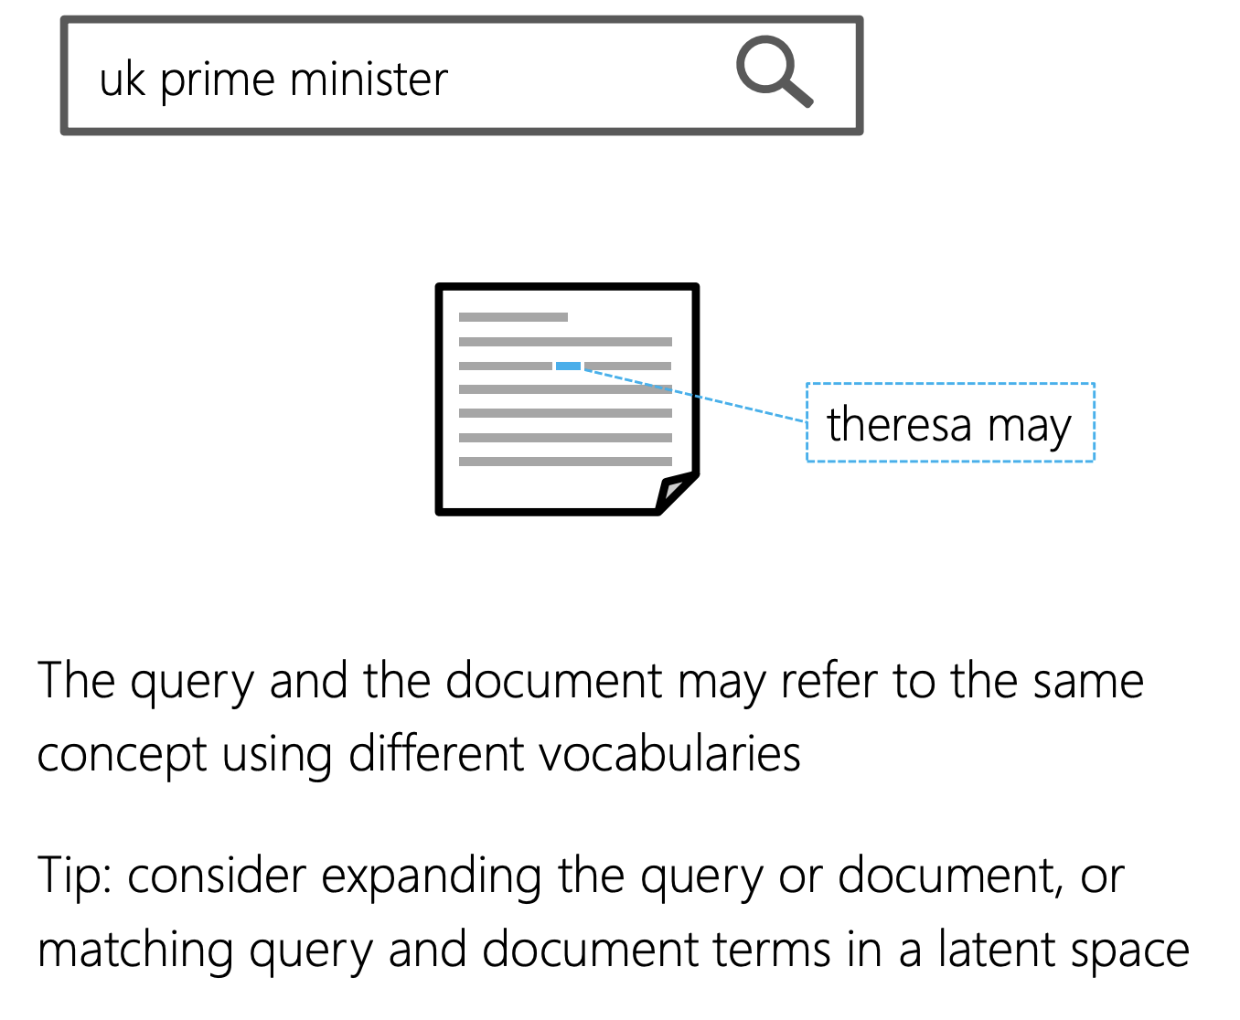
IR Basic Elements
Term frequency
Term weighting
Term saturation
Document length
Term proximity
Term position
Vocabulary mismatch
Term aboutness

Slide 16
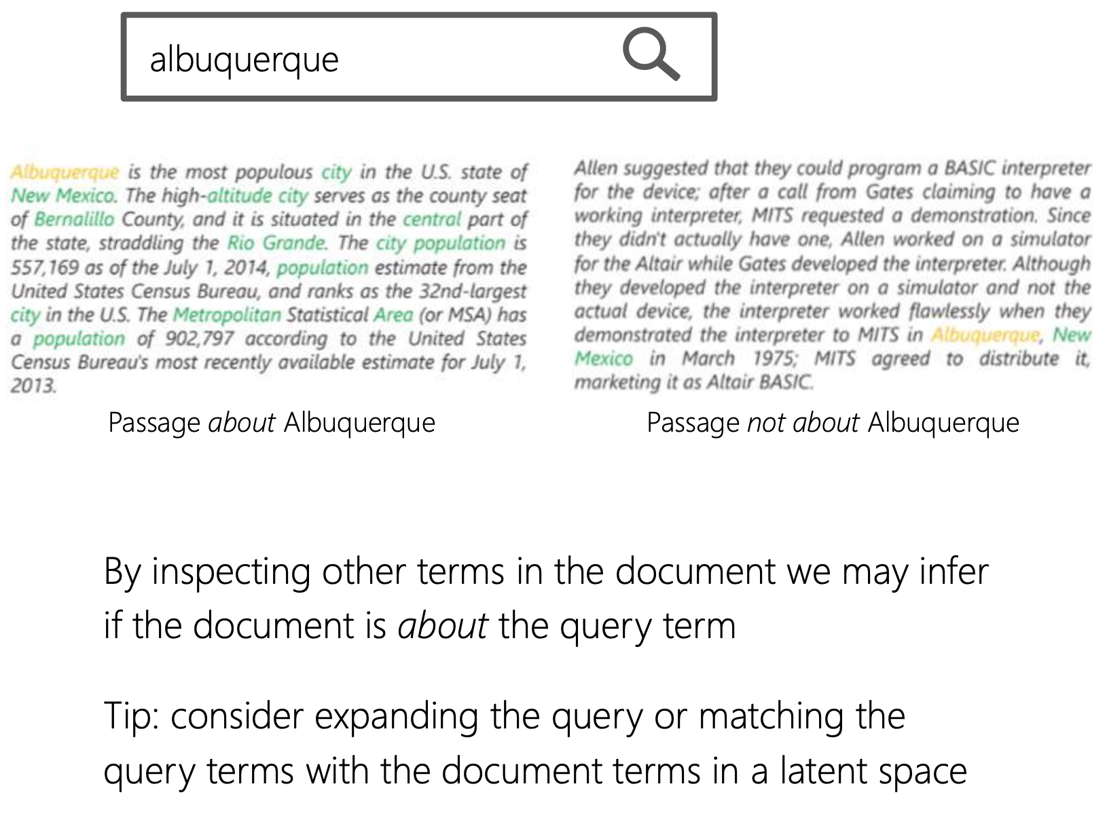
IR Basic Elements
Term frequency
Term weighting
Term saturation
Document length
Term proximity
Term position
Vocabulary mismatch
Term aboutness

Slide 17
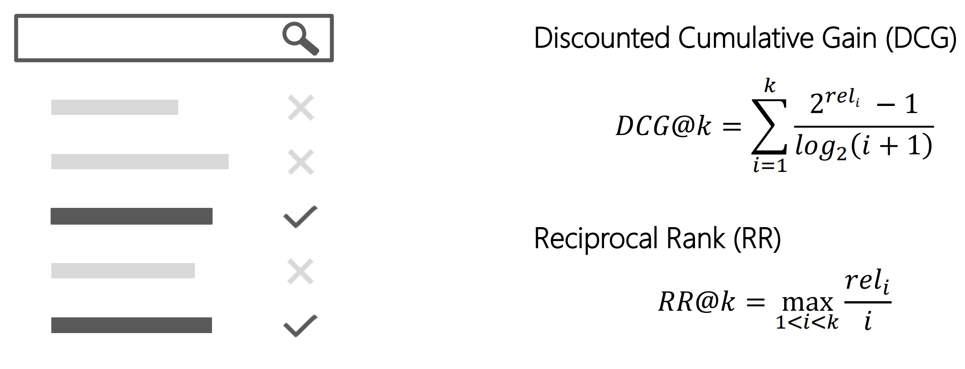
Ranking Metrics Examples

Slide 18
Learning To Rank
Time | Topic
9:00-9:10 | The Search Task
9:10-9:30 | Learning to Rank
9:30-10:30 | Embeddings
10:30-10:40 | Break
10:40-11:15 | Shallow Neural Methods for Ranking
11:15-12:15 | Lunch
12:15-13:45 | Deep Neural Methods for Ranking
13:45-14:00 | Break
14:00-15:00 | Skip-gram Exercise
15:00-16:00 | CBOW Exercise

Slide 19

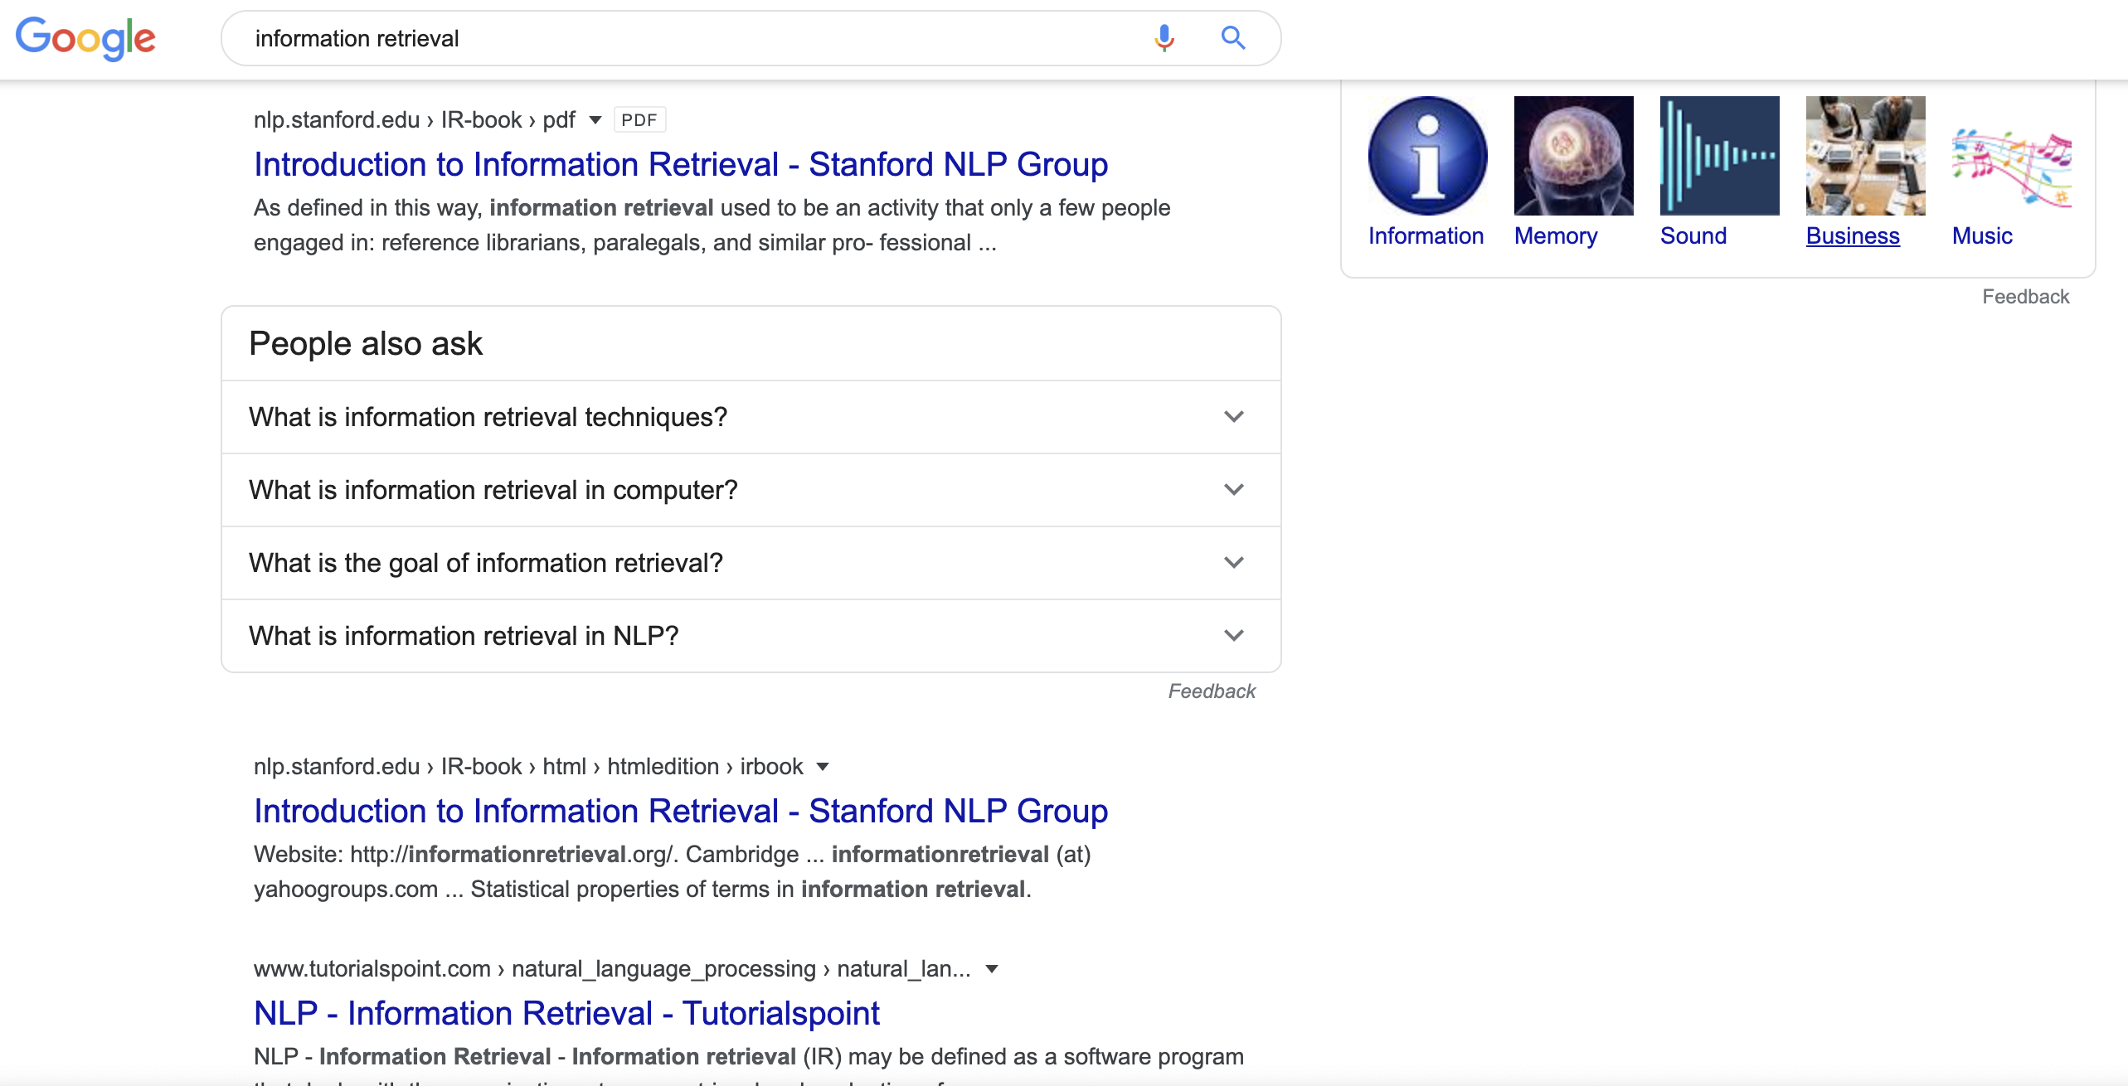

IR Systems

Slide 20
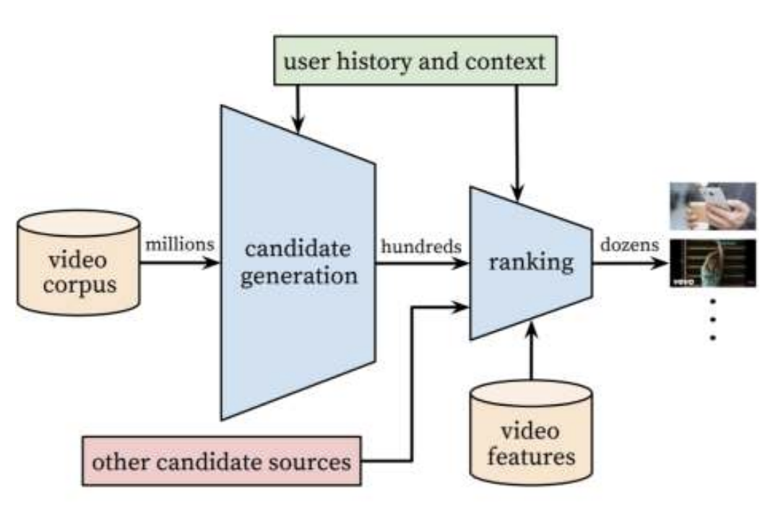
Learning to Rank (LTR)
”... the task to automatically construct a ranking model using training data, such that the model can sort new objects according to their degrees of relevance, preference, or importance.” [Liu, 2009]
Tie-Yan Liu. Learning to rank for information retrieval. Foundation and Trends in Information Retrieval, 2009.

Slide 21
Learning to Rank (LTR)
L2R models represent a rankable item e.g., a document, given some context, e.g., a user-issued query, as a numerical vector 𝑥 ∈ ℝ^{n}
The ranking model 𝑓: 𝑥 → ℝ is trained to map the vector to a real-valued score such that relevant items are scored higher
Tie-Yan Liu. Learning to rank for information retrieval. Foundation and Trends in Information Retrieval, 2009.

Slide 22
The Challenge
Rank based metrics, such as DCG or MRR
are non-smooth / non-differentiable

Slide 23
Features
Traditional L2R models employ hand-crafted features that encode IR insights
They can often be categorized as:
Document-level features or static features e.g., incoming link count and document length
Query-level features e.g., query length
Query-dependent or dynamic features e.g., BM25

Slide 24
Approaches (Liu, 2009)
Pointwise approach - Relevance label 𝑦_{𝑞,𝑑} is a number—derived from binary or graded human judgments or implicit user feedback (e.g., CTR). Typically, a regression or classification model is trained to predict 𝑦_{𝑞,𝑑} given 𝑥_{𝑞,𝑑}
Pairwise approach - Pairwise preference between documents for a query (𝑑_{𝑖} ≻ 𝑑_{𝑗} w.r.t. 𝑞) as label. Reduces to binary classification to predict more relevant document.
Listwise approach - Directly optimize for rank-based metric, such as NDCG—difficult because these metrics are often not differentiable w.r.t. model parameters.

Slide 25
Embeddings
Time | Topic
9:00-9:10 | The Search Task
9:10-9:30 | Learning to Rank
9:30-10:30 | Embeddings
10:30-10:40 | Break
10:40-11:15 | Shallow Neural Methods for Ranking
11:15-12:15 | Lunch
12:15-13:45 | Deep Neural Methods for Ranking
13:45-14:00 | Break
14:00-15:00 | Skip-gram Exercise
15:00-16:00 | CBOW Exercise

Slide 26
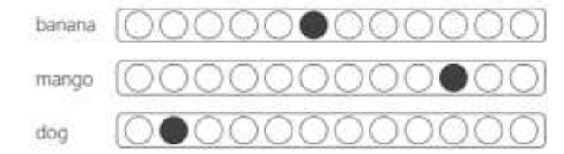
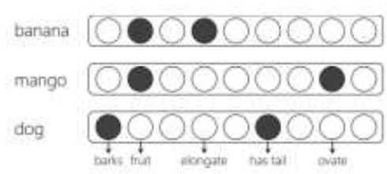
Types of Vector Representations
Local (One hot) - Every term in vocabulary T is represented by a binary vector of length |T|, where one position in the vector is set to one and the rest to zero
Distributed - Every term in vocabulary T is represented by a real-valued vector of length k. The vector can be sparse or dense. The vector dimensions may be observed (e.g., hand-crafted features) or latent (e.g., embedding dimensions)

Slide 27
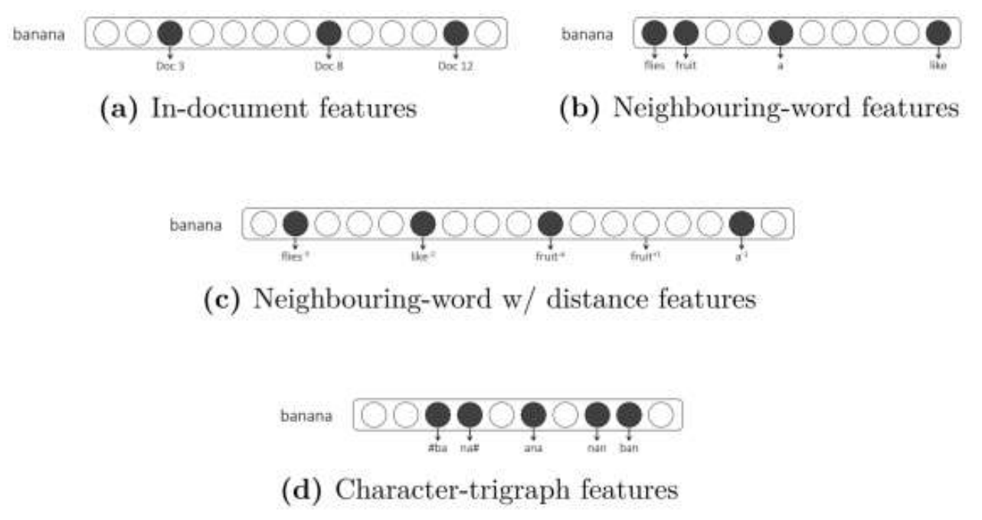
Explicit Distributed Representations
The choice of features is a key consideration
The distributional hypothesis states that terms that are used (or occur) in similar context tend to be semantically similar [Harris, 1954]
Firth [1957] famously purported this idea of distributional semantics by stating “a word is characterized by the company it keeps”

Slide 28
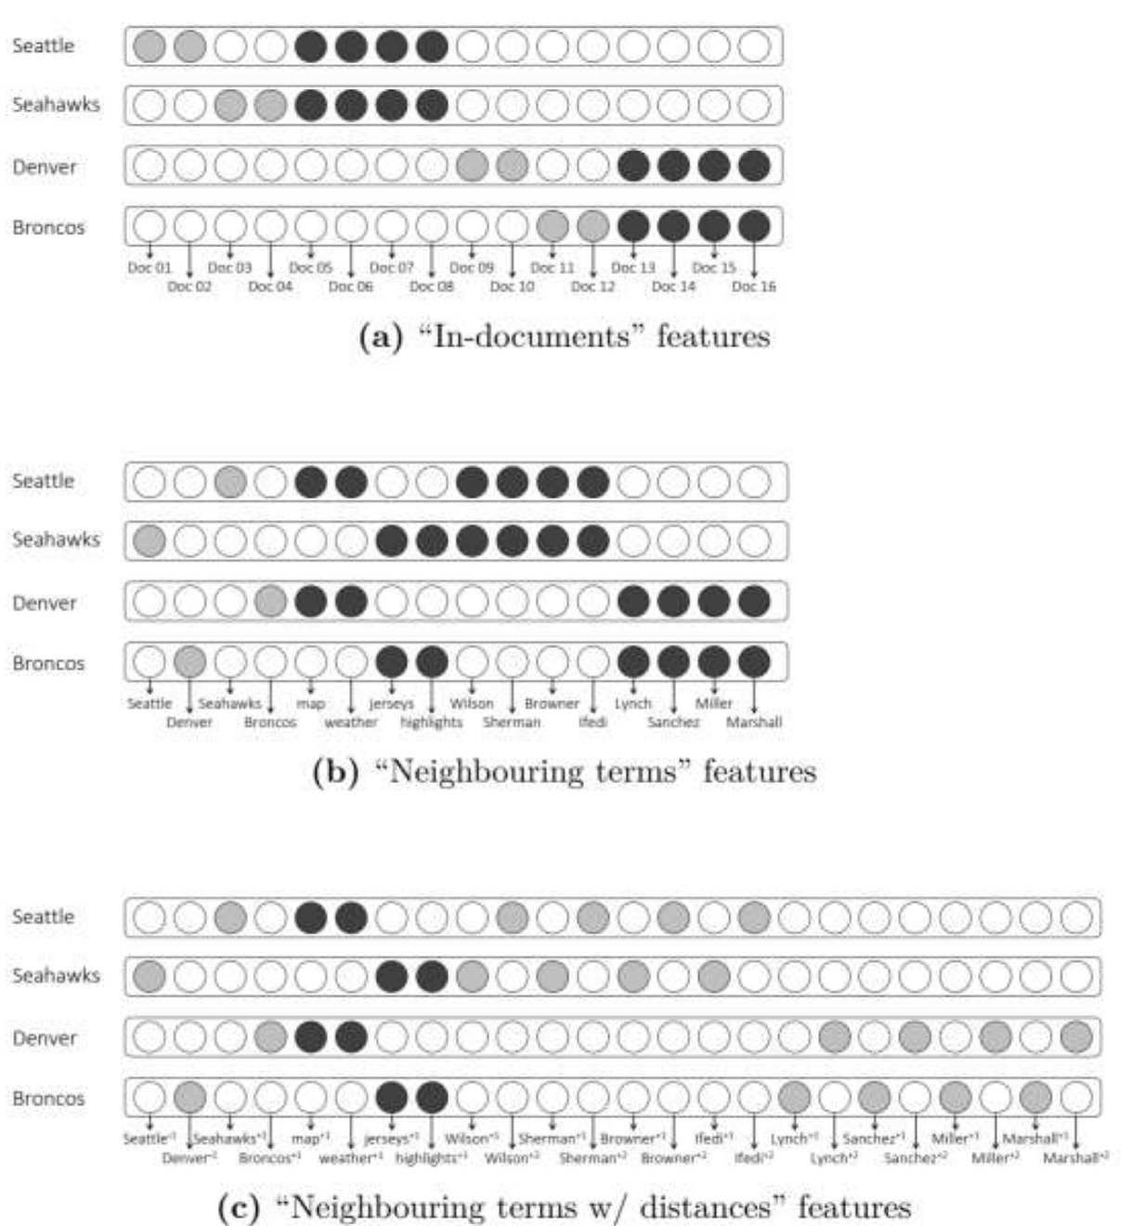
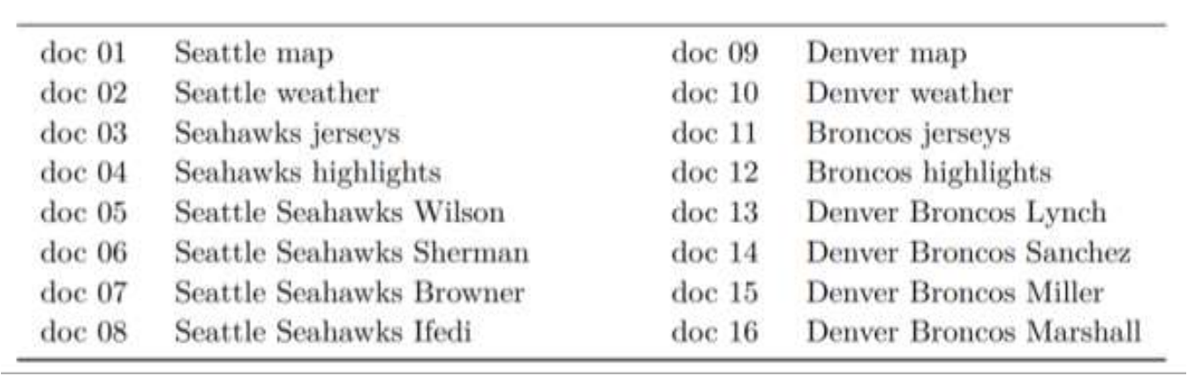
Explicit Distributed Representations - Example

Slide 29
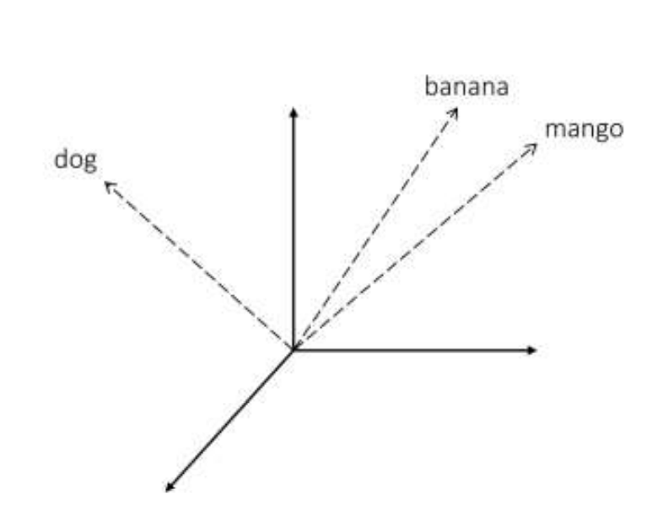
Embeddings (Implicit Distributed Representations)
An embedding is a representation of items in a new space such that the properties of, and the relationships between, the items are preserved from the original representation

Slide 30
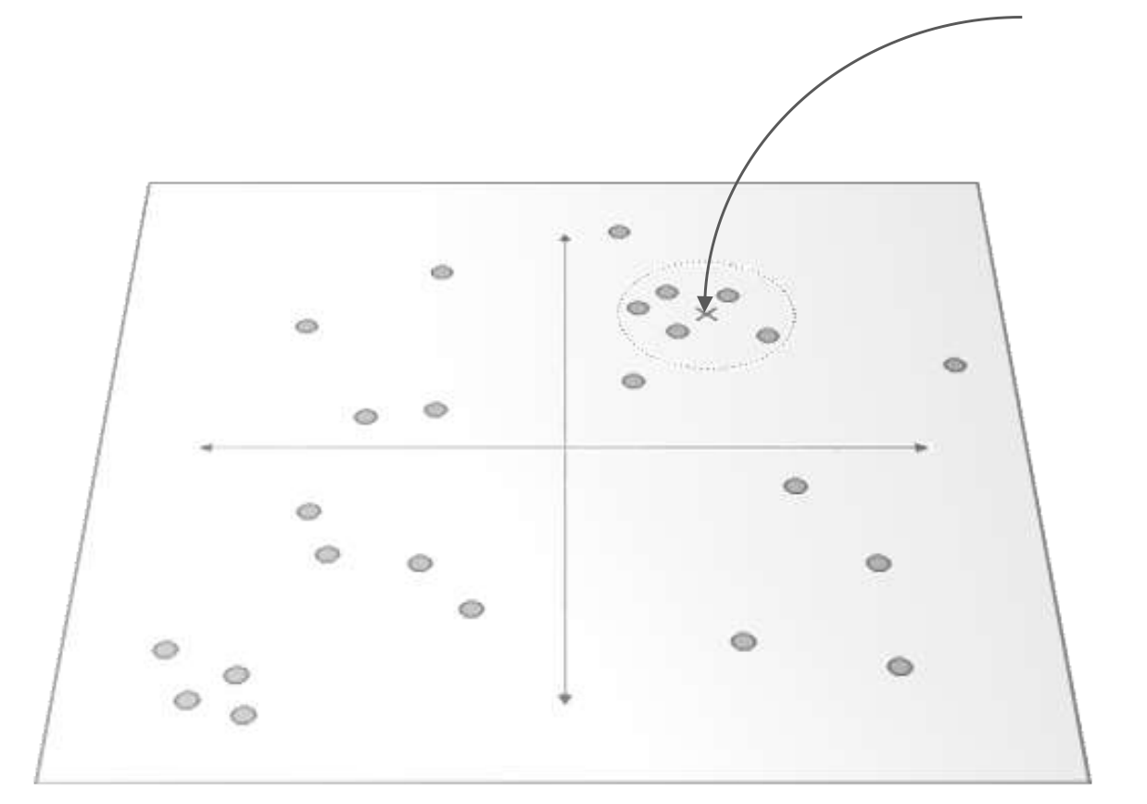
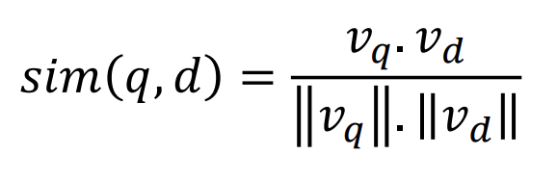
Retrieval Using Vector Representations
Map both query and candidate documents into the same vector space
Retrieve documents closest to the query e.g., using vector space model
Where, 𝑣_{𝑞} and 𝑣_{𝑑} are vectors representing the query and a document

Slide 31
Embeddings
Compared to observed feature spaces:
Embeddings typically have fewer dimensions
The space may have more disentangled principle components
The latent representations may generalize better
The dimensions may be less interpretable

Slide 32
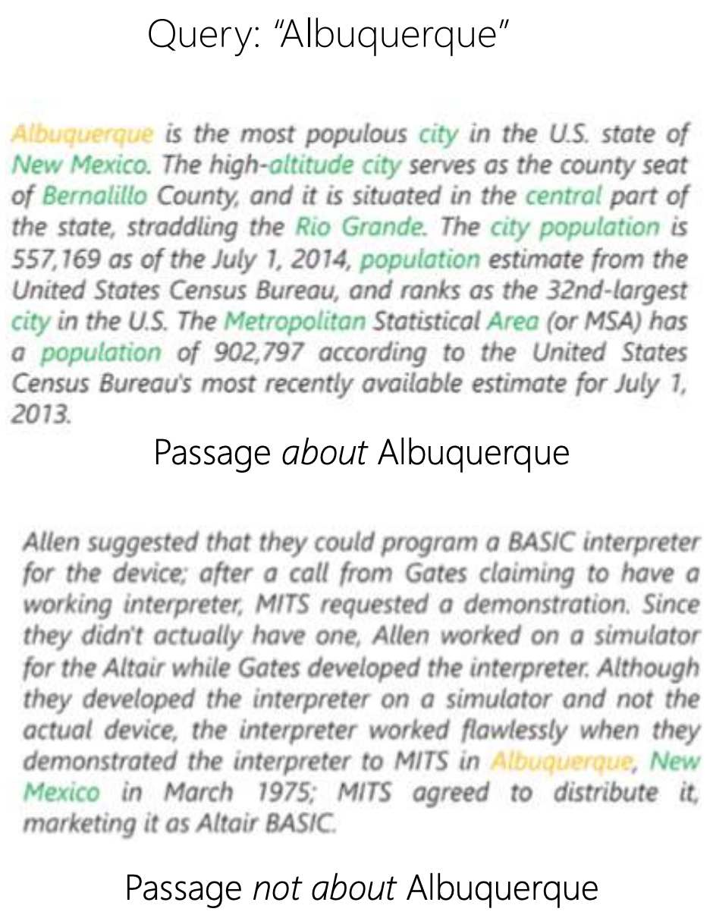
Example
In an explicit vector space, both these passages are equidistant from the query “Albuquerque”
A latent feature representation may put the first passage closer to the query because of terms like “population” and “area”

Slide 33
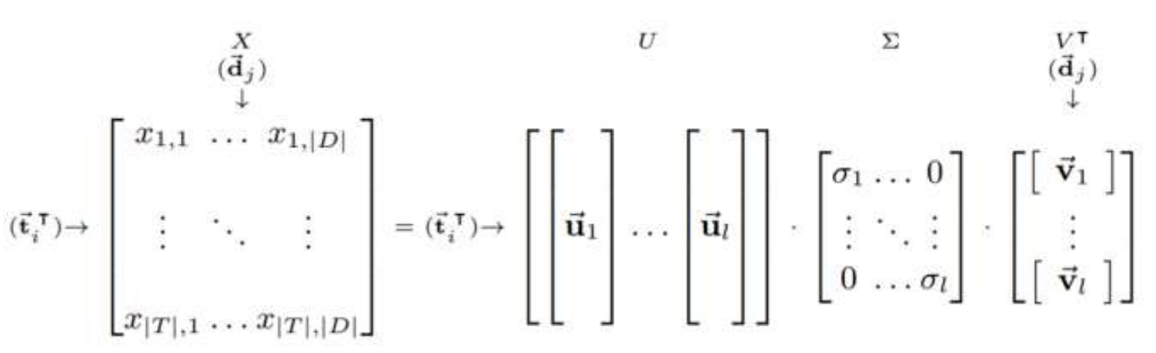
Latent Semantic Analysis (LSA)
Perform matrix factorization to find the “middle” matrix
Scott C. Deerwester, Susan T Dumais, Thomas K. Landauer, George W. Furnas, and Richard A. Harshman. Indexing by latent semantic analysis. JASIS, 1990.
Notes:
U – term matrix
V – document vector
X – Full matrix

Slide 34
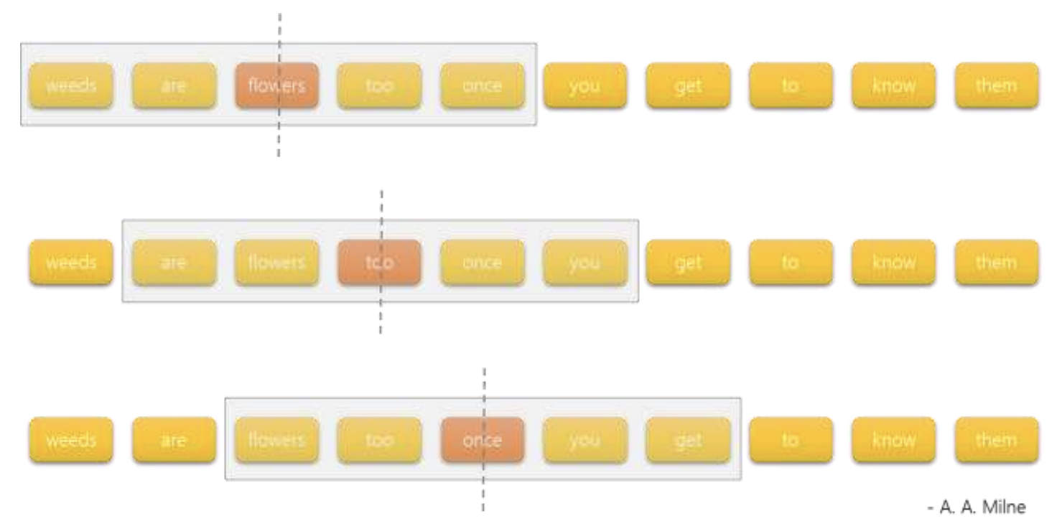
Word2Vec
Goal: simple (shallow) neural model learning from billion words scale corpus
Predict middle word from neighbors within a fixed size context window
Two different architectures:
Skip-grams
CBOW
Tomas Mikolov, Ilya Sutskever, Kai Chen, Greg S Corrado, and Jeff Dean. Distributed representations of words and phrases and their compositionality. In NIPS, 2013.

Slide 35
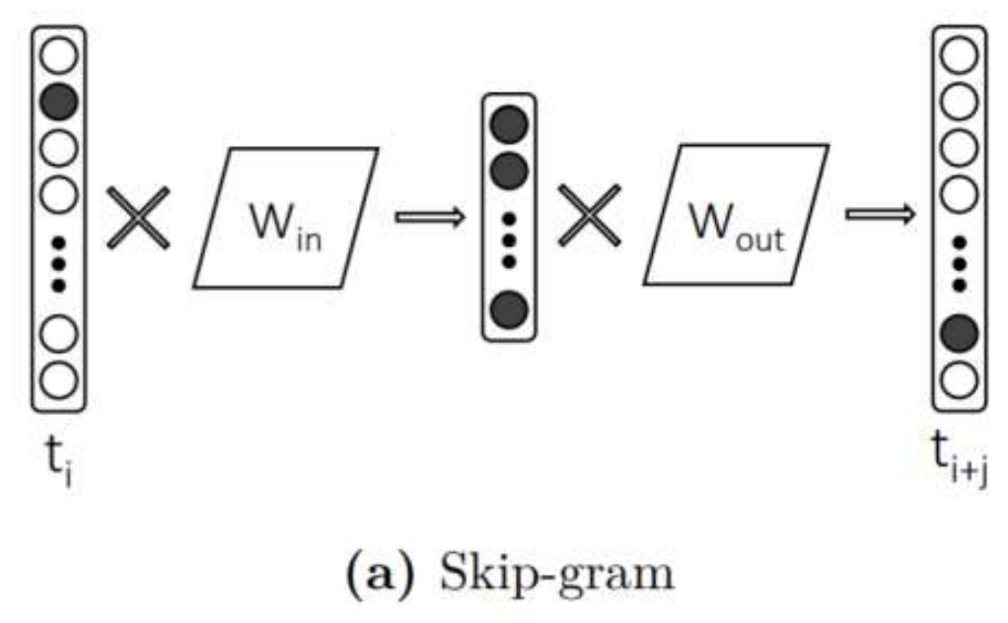
Skip-grams
Predict neighbor 𝑡_{𝑖+𝑗} given term 𝑡_{𝑖}

Slide 36
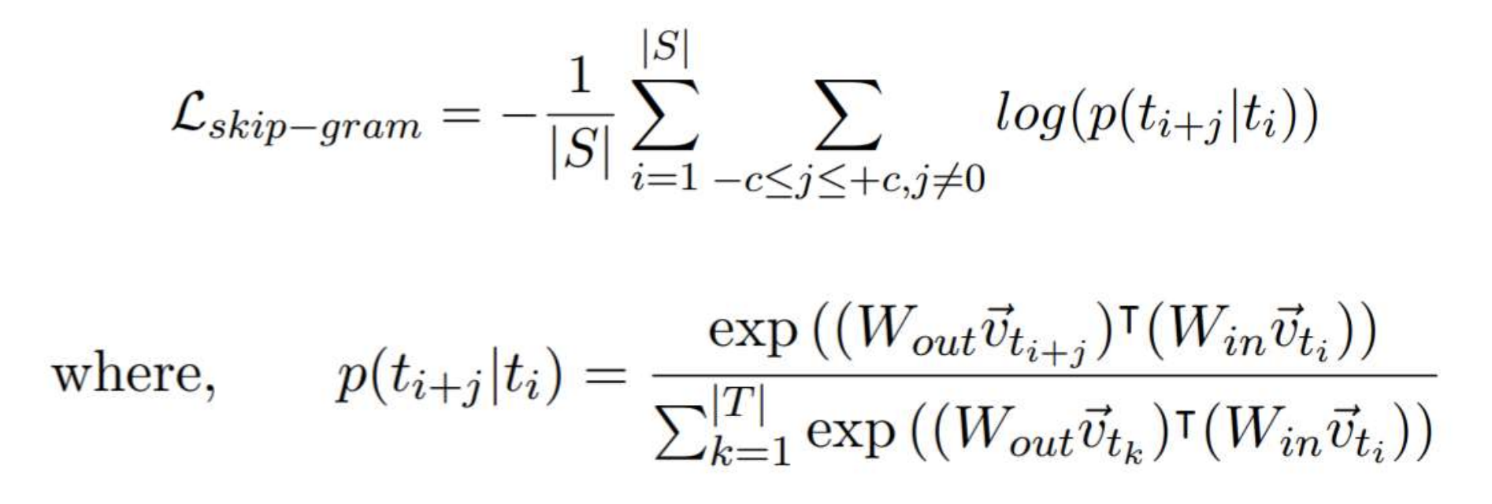
Skip-grams Loss
S is the set of all windows over the training text
c is the number of neighbors we need to predict on either side of the term 𝑡_{𝑖}
Full softmax is computationally impractical - hierarchical softmax or negative sampling is employed instead
Notes:
Hierarchical softmax – we use a binary tree in which the leaves are the words and we group them randomly to parents. Then we use the max score of the childs and use it for the loss calculation. Since it’s very sparse, we get a good approximation.
Negative sampling – we don’t calculate the full loss – but just for the output word and 5-20 more random (negative) words

Slide 37
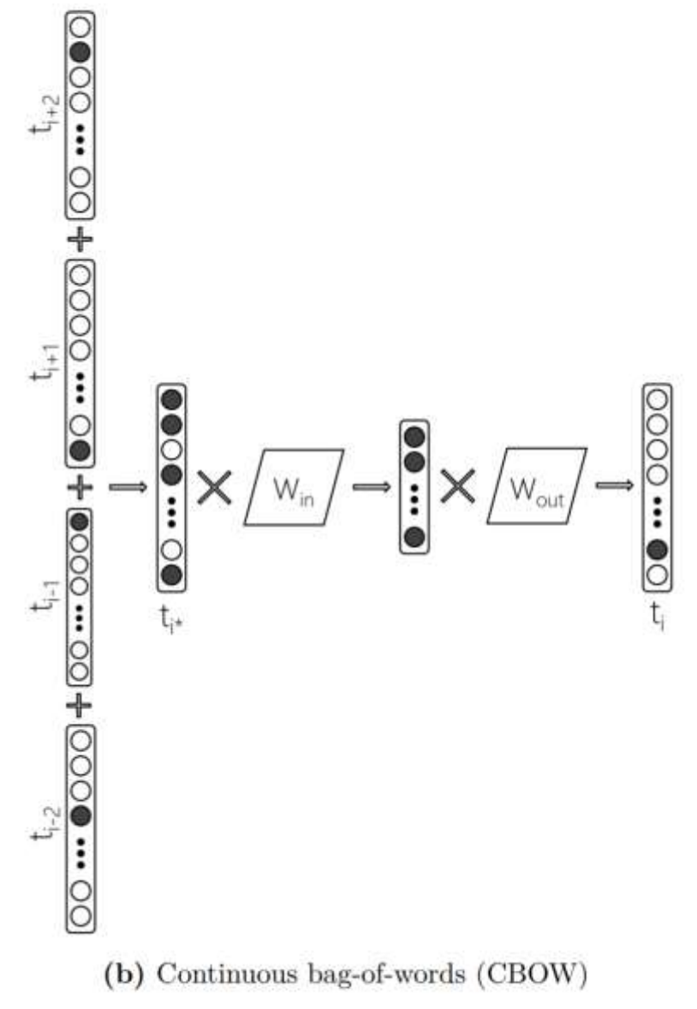
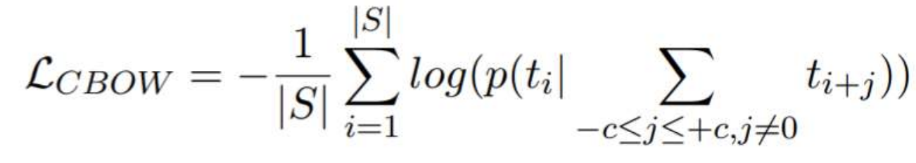
Continuous Bag-of-Words (CBOW)
Predict the middle term 𝑡_{𝑖} given {𝑡_{𝑖−𝑐} , … ,𝑡_{𝑖−1},𝑡_{𝑖+1}, … ,𝑡_{𝑖+𝑐} }
Loss:
Note: from every window of text skip-gram generates 2 x c training samples whereas CBOW generates one – that’s why CBOW trains faster than skip-gram

Slide 38
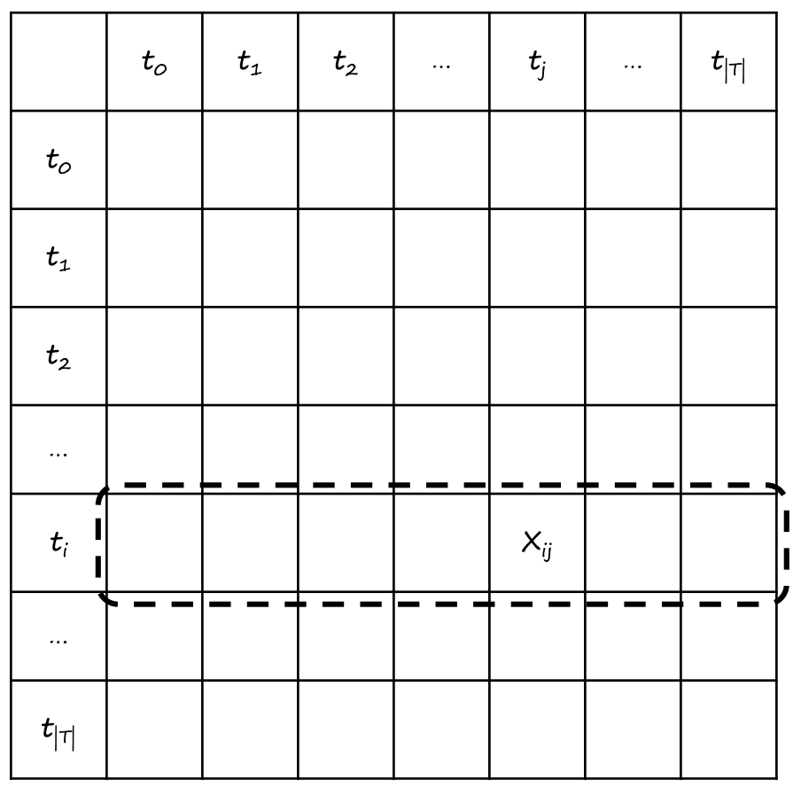
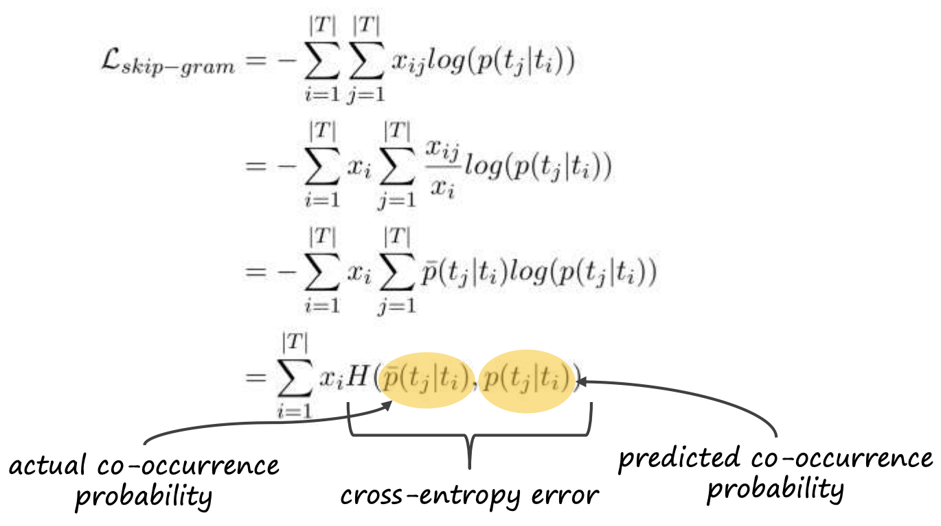
GLOVE
Uses a matrix interpretation of word2vec
Let 𝑥_{𝑖,𝑗} be the frequency of the pair 𝑡_{𝑖} ,𝑡_{𝑗} in the training data, then

Slide 39
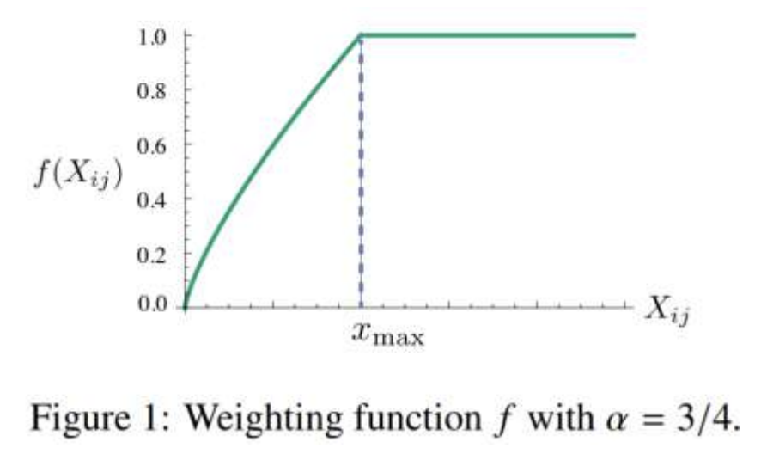
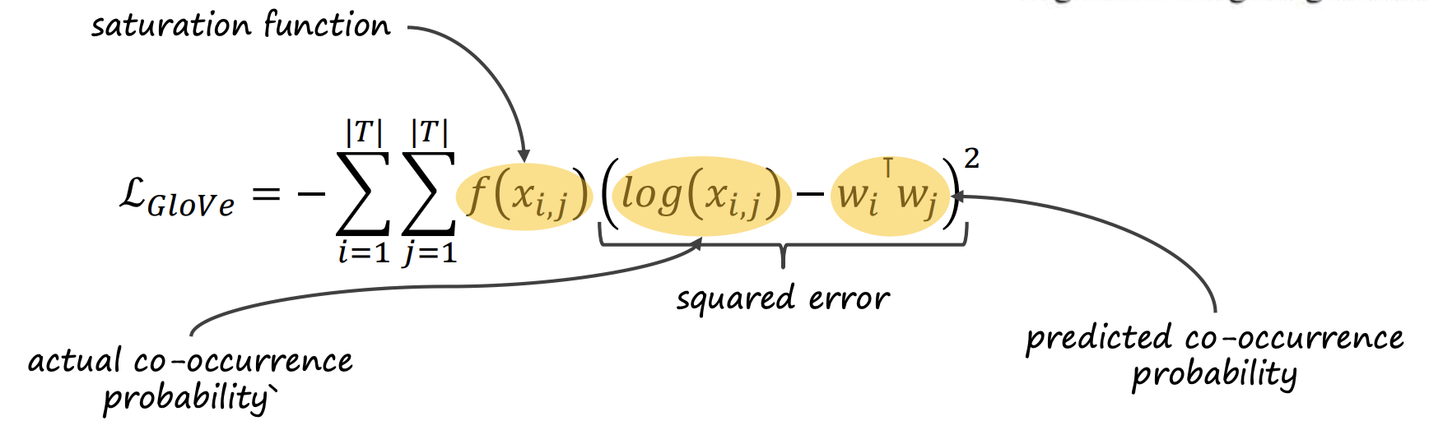
GLOVE
Replace the cross-entropy error with a squared-error and apply a saturation function f(…) over 𝑥_{i,j}

Slide 40
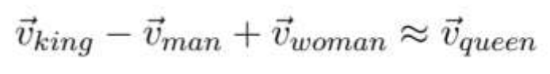
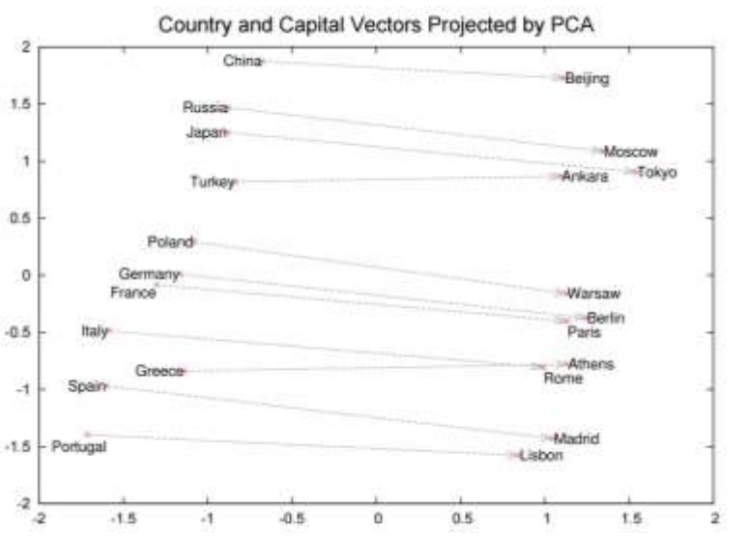
Word Analogies with Word2Vec
W2v is popular for word analogy tasks

Slide 41
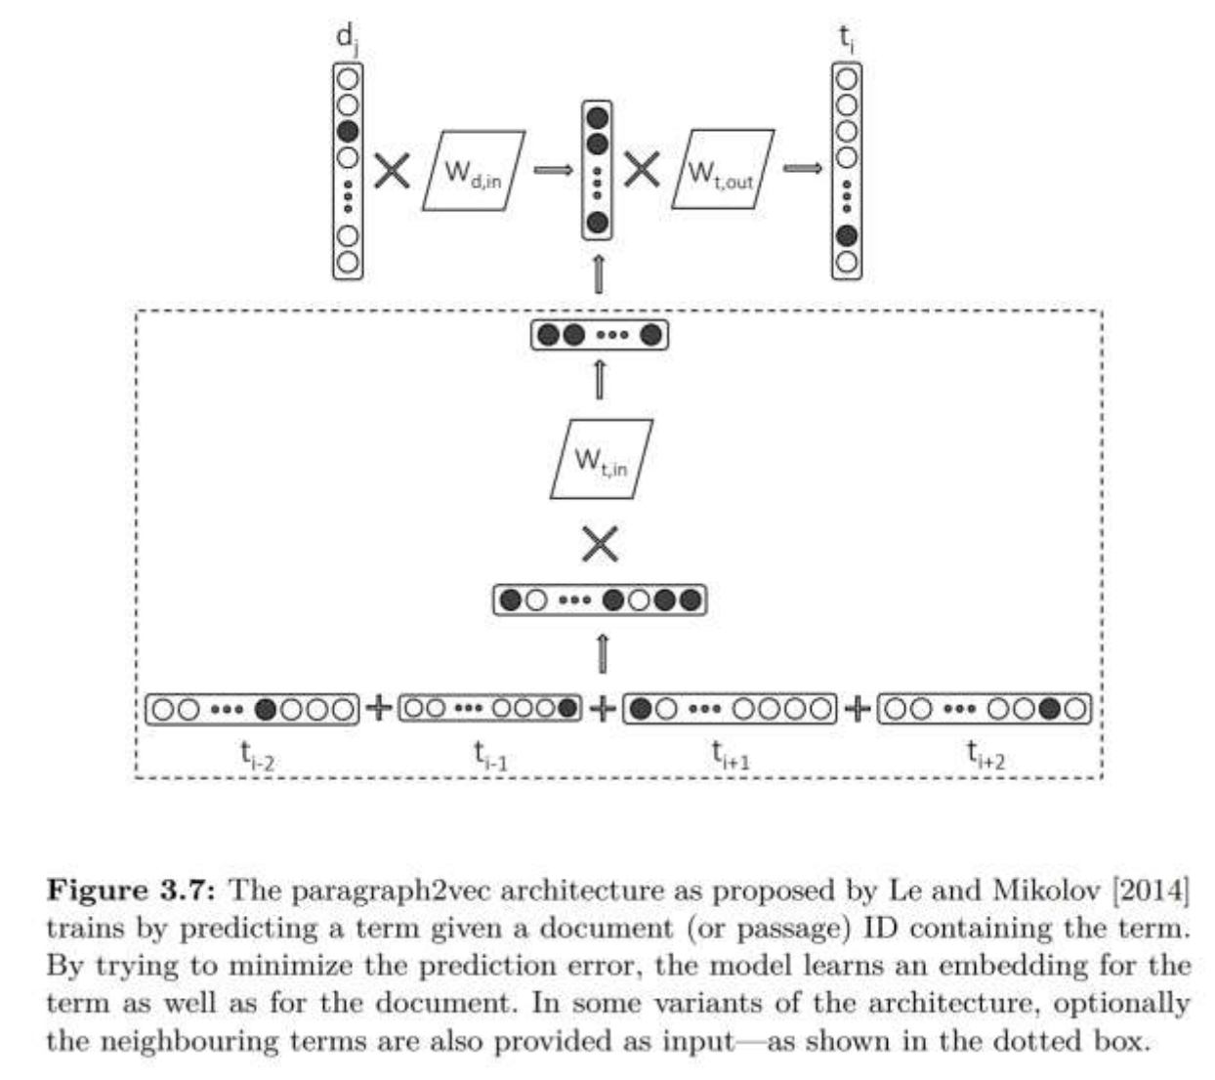
Paragraph2Vec (Doc2Vec)
W2v style model where context is document, not neighboring term
Quoc V Le and Tomas Mikolov. Distributed representations of sentences and documents. In ICML, 2014

Slide 42
Recap – Learning Term Embeddings
Learn from <term, context, count> data
Choice of context (e.g., neighboring term or container document) defines what relationship you are modeling
Choice of learning algorithm (e.g., matrix factorization or SGD) defines how well you model the relationship
Choice of context and learning algorithm are independent – you can use matrix factorization with neighboring term context, or a w2v-style neural network with document context (e.g., paragraph2vec)

Slide 43
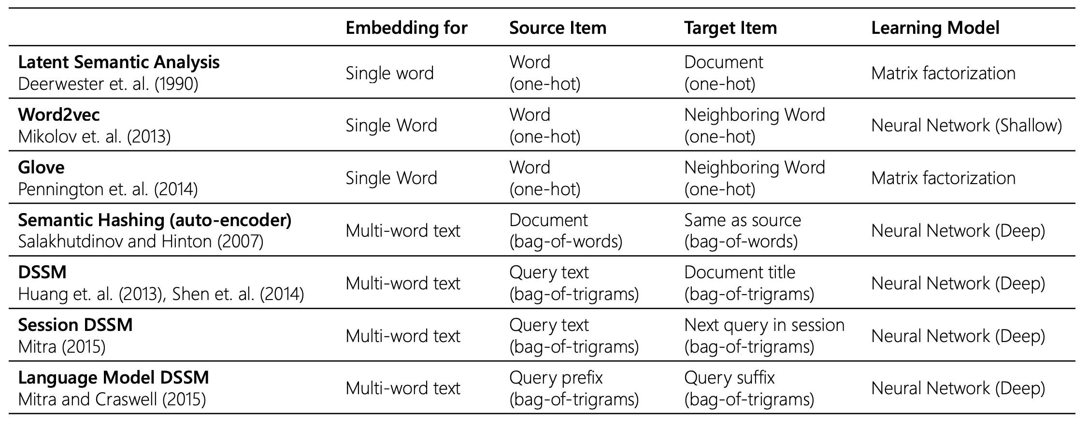
Embedding Algorithms

Slide 44
Course Recap Before Moving On
RNN
Siamese Network
Autoencoder
Convolution
Pooling
Attention
Residual Network
Normalization
Regularization
Notes:
Autoencoder – reconstruction of data
C

Slide 45
Contextualized Deep Word Embeddings
Each word should have a representation which is based on its context
I called the bank to review my deposit
I ate a pizza near the bank

Slide 46
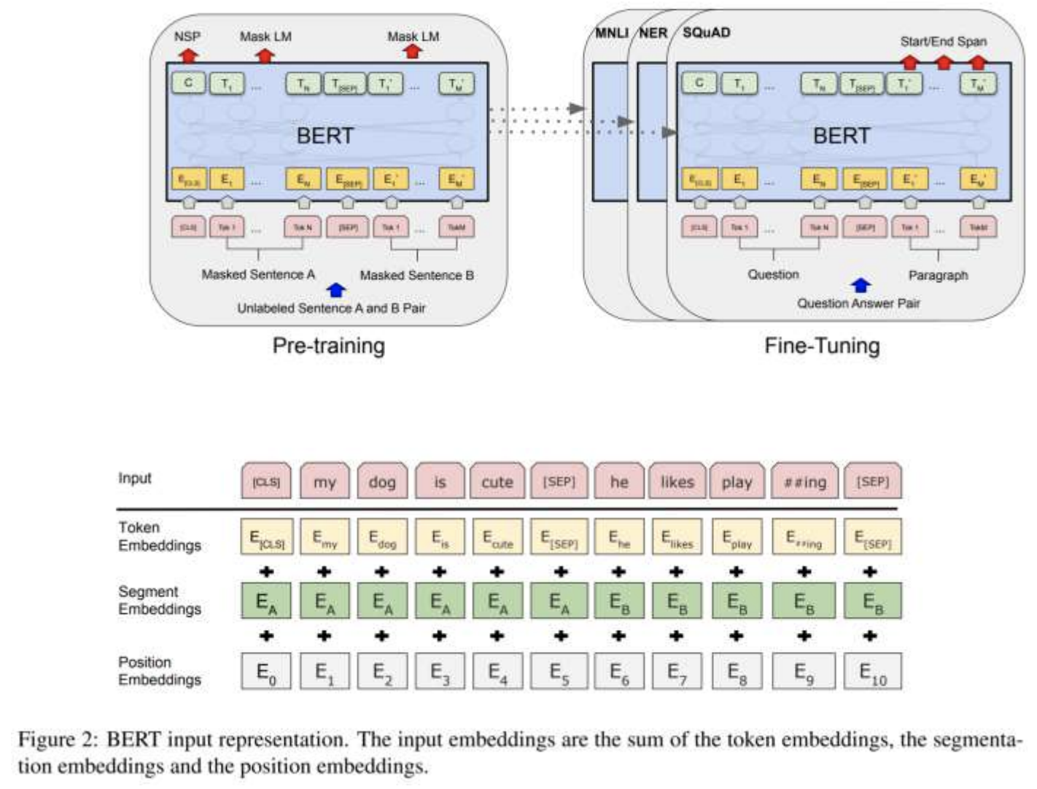
BERT
Stacked transformer layers
Pretrained on two tasks:
• Masked language modeling
• Next sentence prediction
We learn:
WordPiece embedding
Position embedding
Segment embedding
Jacob Devlin, Ming-Wei Chang, et al. Bert: Pre-training of deep bidirectional transformers for language understanding. In NAACL, 2018
http://jalammar.github.io/illustrated-bert/
Notes:
WordPiece - an algorithm to divide words into pieces. All of the English vocabulary can be divided into 30k words
All vectors
WordPiece embedding – nx768 in size – n is the input length
Position embedding – we learn representation (bias) based on the position of the word in the phrase
Segment embedding – we try to predict each word which segment it belongs to (0 0 0 0 1 1 1)

Slide 47
BREAK
Time | Topic
9:00-9:10 | The Search Task
9:10-9:30 | Learning to Rank
9:30-10:30 | Embeddings
10:30-10:40 | Break
10:40-11:15 | Shallow Neural Methods for Ranking
11:15-12:15 | Lunch
12:15-13:45 | Deep Neural Methods for Ranking
13:45-14:00 | Break
14:00-15:00 | Skip-gram Exercise
15:00-16:00 | CBOW Exercise

Slide 48
Shallow Neural Methods for Ranking
Time | Topic
9:00-9:10 | The Search Task
9:10-9:30 | Learning to Rank
9:30-10:30 | Embeddings
10:30-10:40 | Break
10:40-11:15 | Shallow Neural Methods for Ranking
11:15-12:15 | Lunch
12:15-13:45 | Deep Neural Methods for Ranking
13:45-14:00 | Break
14:00-15:00 | Skip-gram Exercise
15:00-16:00 | CBOW Exercise

Slide 49
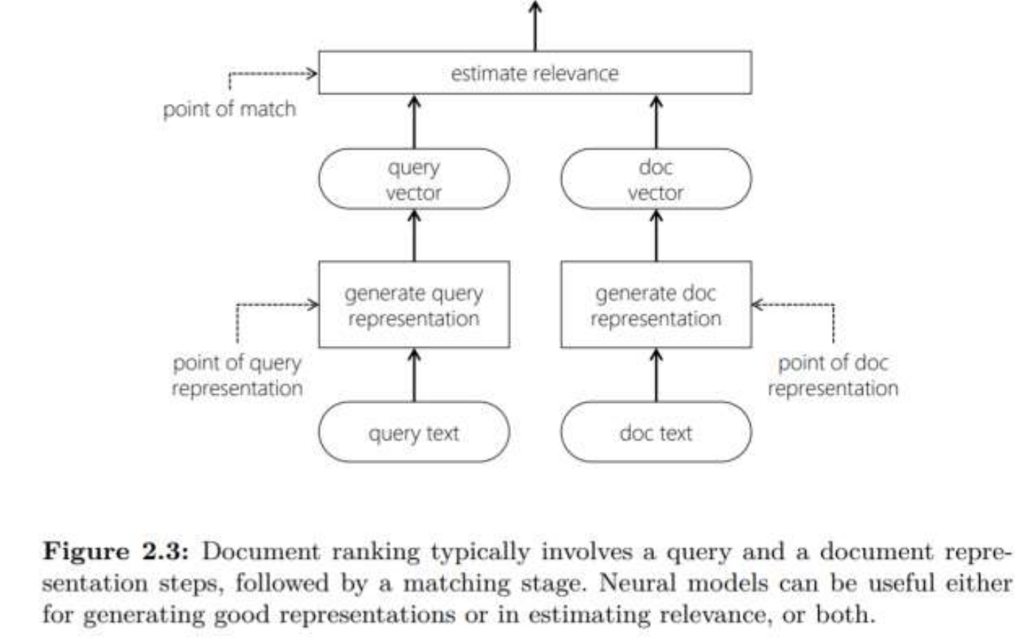
Retrieval Using Vector Representations
Generate vector representation of query
Generate vector representation of document
Estimate relevance from q-d vectors

Slide 50
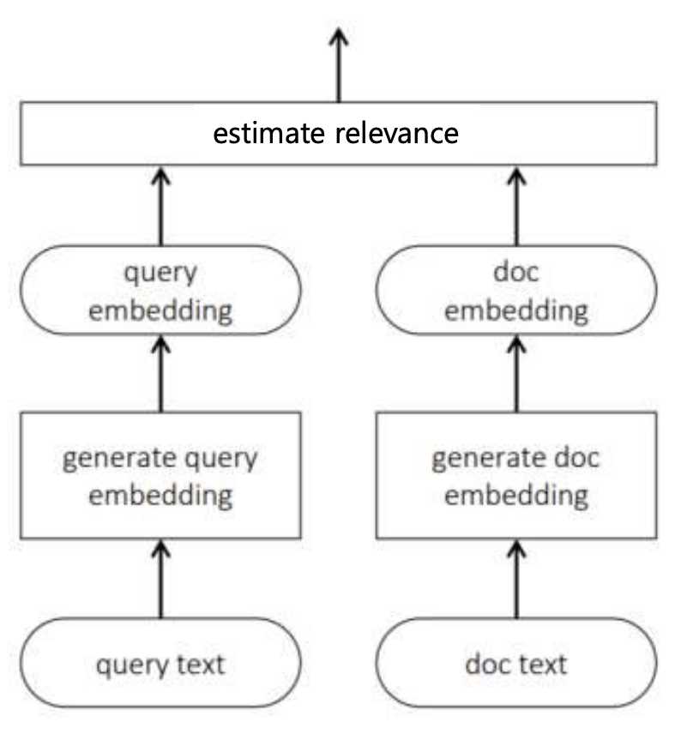
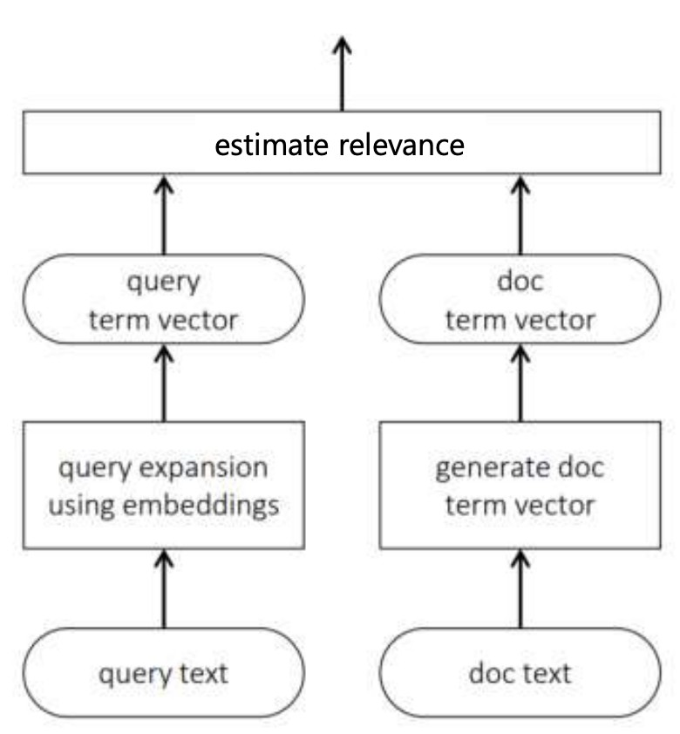
Incorporating Term Embedding for Matching
(1) Compare query and document directly in the embedding space
(2) Use embeddings to generate suitable query expansions
Notes:
(1)
Generalized Language Model [Ganguly et al., 2015]
Neural Translation Language Model [Zuccon et al., 2015]
Average term embeddings [Le and Mikolov, 2014, Nalisnick et al., 2016, Zamani and Croft, 2016, and others]
Word mover’s distance [Kusner et al., 2015, Guo et al., 2016]
(2)

Slide 51
Incorporating Term Embedding for Matching
(1) Compare query and document directly in the embedding space
(2) Use embeddings to generate suitable query expansions
Notes:
(1)
Generalized Language Model [Ganguly et al., 2015]
Neural Translation Language Model [Zuccon et al., 2015]
Average term embeddings [Le and Mikolov, 2014, Nalisnick et al., 2016, Zamani and Croft, 2016, and others]
Word mover’s distance [Kusner et al., 2015, Guo et al., 2016]
(2)

Slide 52
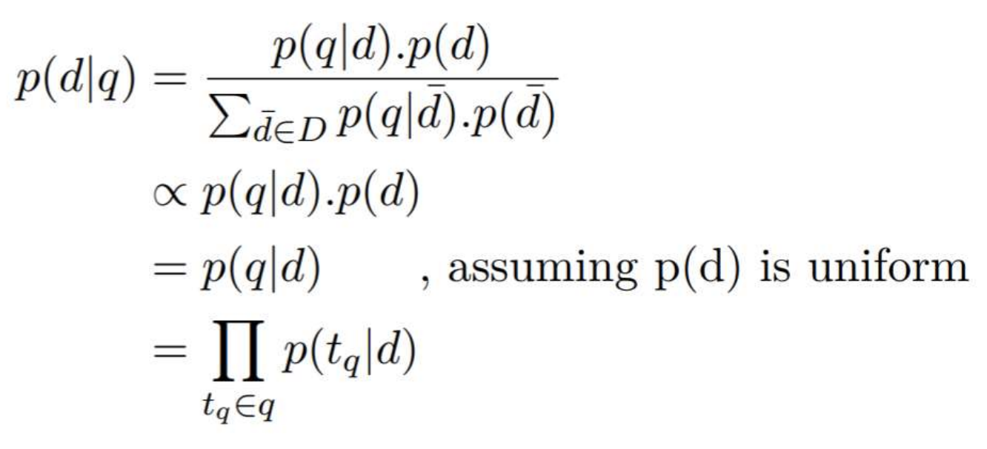
Generalized Language Model
Traditional language modeling based IR approach may estimate q-d relevance as follows:

Slide 53
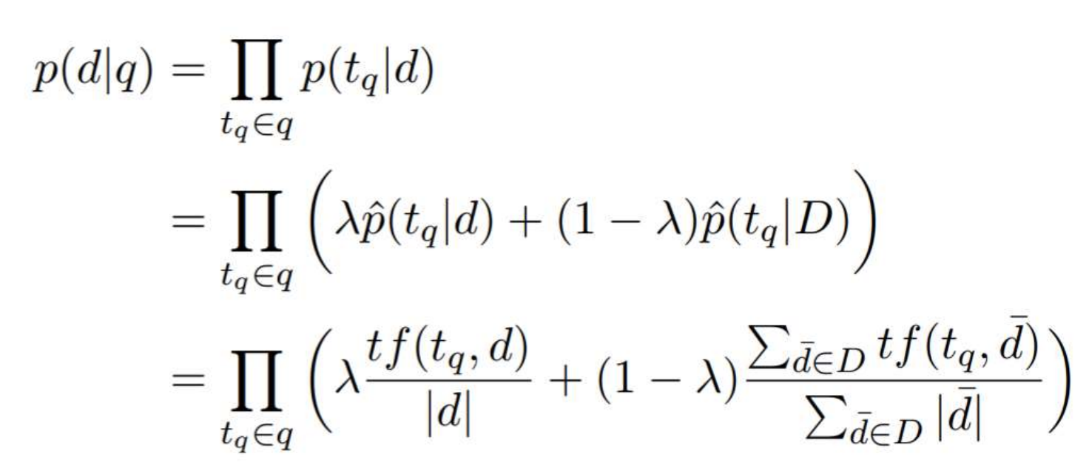
Generalized Language Model
Traditional language modeling based IR approach may estimate q-d relevance as follows:
Notes:
Smoothing effect

Slide 54
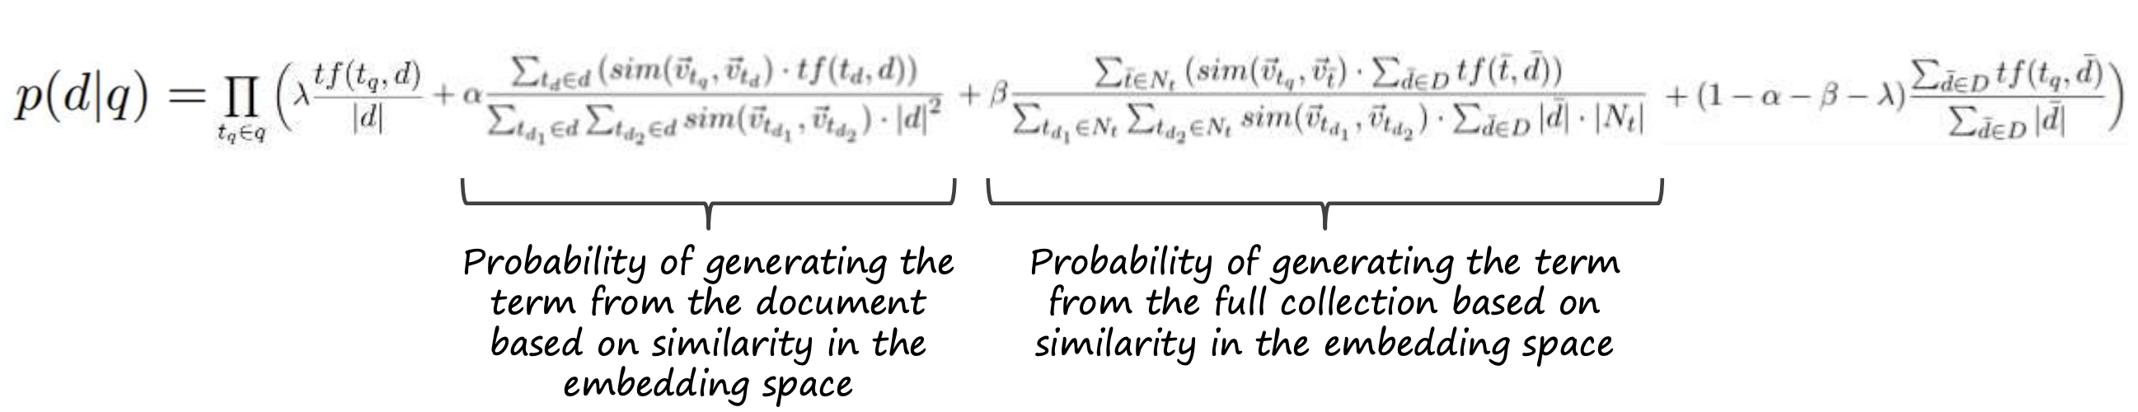
Generalized Language Model
GLM includes additional smoothing based on term similarity in the embedding space
Debasis Ganguly, Dwaipayan Roy, Mandar Mitra, and Gareth JF Jones. Word embedding based generalized language model for information retrieval. In SIGIR, 2015.
Notes:
Smoothing effect

Slide 55
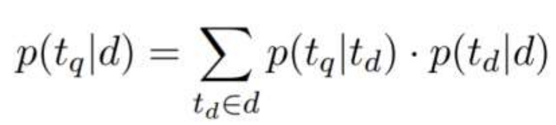
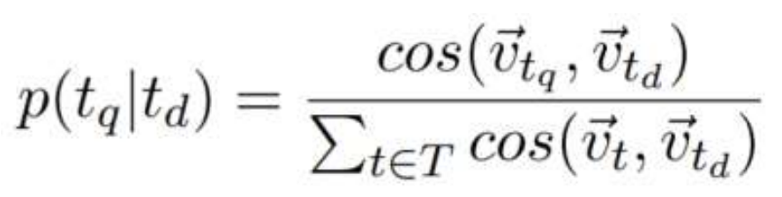
Neural Translation Language Model (NTLM)
NTLM estimates 𝑝(𝑡_{𝑞}|𝑡_{𝑑}) from q-d paired data similar to statistical machine translation:
Guido Zuccon, Bevan Koopman, Peter Bruza, and Leif Azzopardi. Integrating and evaluating neural word embeddings in information retrieval. In ADCS, 2015.

Slide 56
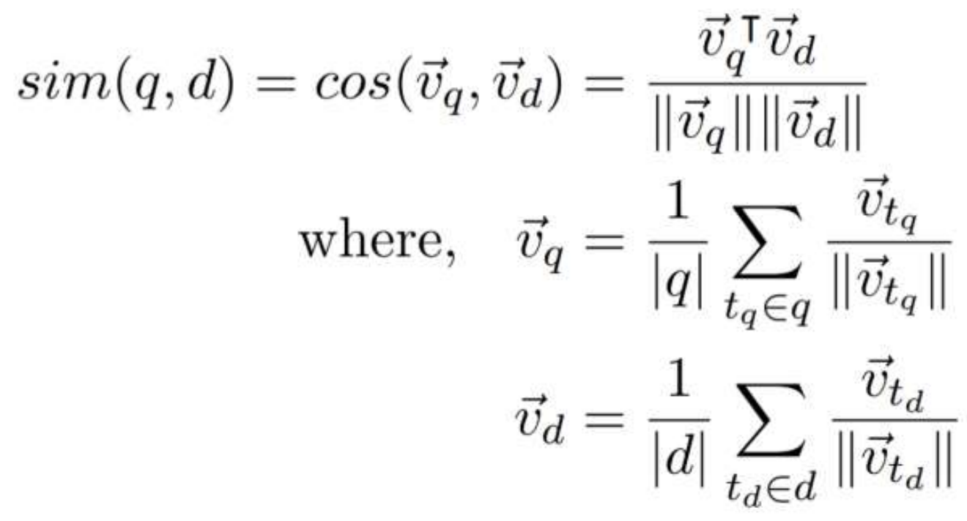
Average Term Embeddings
Q-D relevance estimated by computing cosine similarity between centroid of q and d term embeddings
Eric Nalisnick, Bhaskar Mitra, Nick Craswell, and Rich Caruana. Improving document ranking with dual word embeddings. In WWW, 2016.
Bhaskar Mitra, Eric Nalisnick, Nick Craswell, and Rich Caruana. A dual embedding space model for document ranking. arXiv preprint arXiv:1602.01137, 2016.

Slide 57
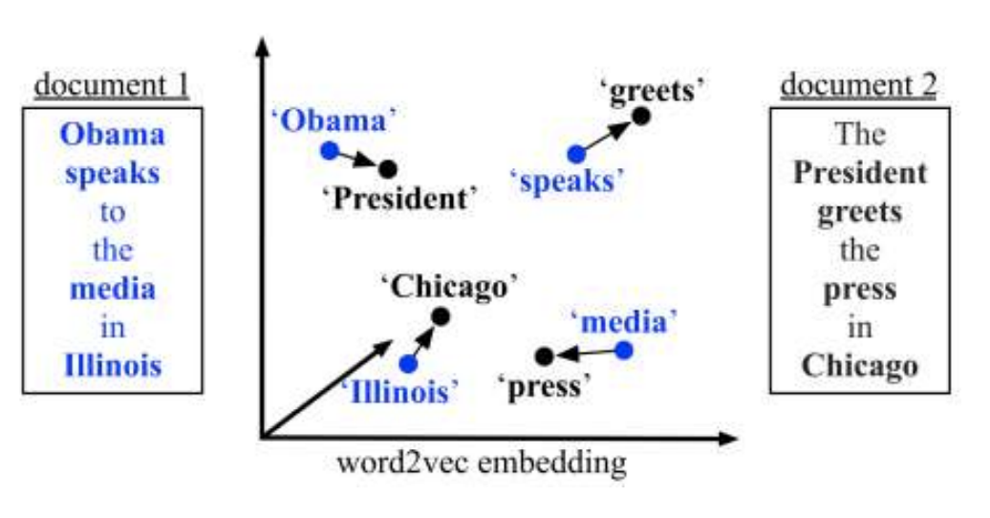
Word Mover’s Distance
Based on the Earth Mover’s Distance (EMD) [Rubner et al., 1998]
Originally proposed by Wan et al. [2005, 2007], but used WordNet and topic categories
Kusner et al. [2015] incorporated term embeddings
Adapted for q-d matching by Guo et al. [2016]
Jiafeng Guo, Yixing Fan, Qingyao Ai, and W Bruce Croft. Semantic matching by non-linear word transportation for information retrieval. In CIKM, 2016.
Notes:
EMD – how do you move one pile of dust from one place to another with minimal flow
In our case – how to convert (I,e. what is the distance between the word embeddings distribution of the query and the document)

Slide 58


Slide 59
Choice of Term Embeddings for Document Ranking
RECAP: for the query “Albuquerque” the relevant document may contain terms like “population” and “area”
Documents about “Santa Fe” not relevant for this query
“Albuquerque” ↔ “population” (Topically similar)
“Albuquerque” ↔ “Santa Fe” (Typically similar)
Standard LSA and para2vec capture topical similarity, whereas w2v and GloVe capture a mix of both Top/Typ-ical

Slide 60
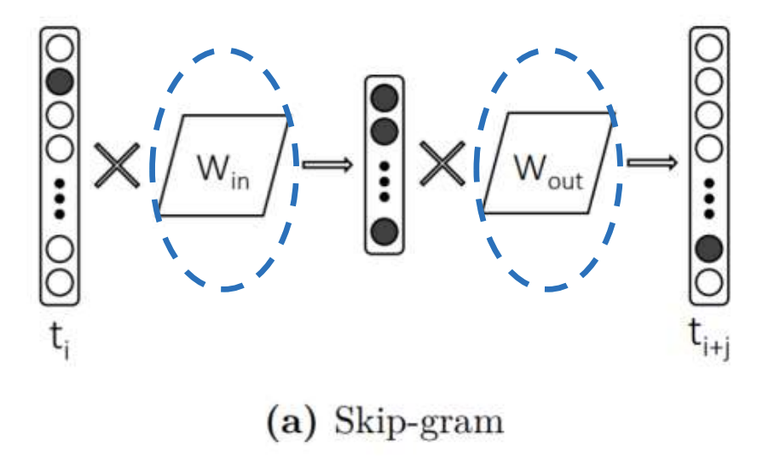
Skip-grams Recap
What if I told you that everyone using word2vec is throwing half the model away?
Eric Nalisnick, Bhaskar Mitra, Nick Craswell, and Rich Caruana. Improving document ranking with dual word embeddings. In WWW, 2016
Bhaskar Mitra, Eric Nalisnick, Nick Craswell, and Rich Caruana. A dual embedding space model for document ranking. arXiv preprint arXiv:1602.01137, 2016.

Slide 61
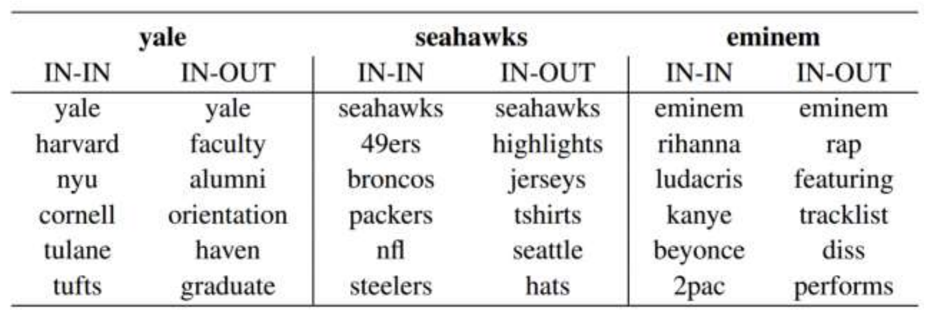
Dual Embedding Space Model
IN-OUT captures a more Topical notion of similarity than IN-IN and OUT-OUT
Effect is exaggerated when embeddings are trained on short text (e.g., queries)
Eric Nalisnick, Bhaskar Mitra, Nick Craswell, and Rich Caruana. Improving document ranking with dual word embeddings. In WWW, 2016
Bhaskar Mitra, Eric Nalisnick, Nick Craswell, and Rich Caruana. A dual embedding space model for document ranking. arXiv preprint arXiv:1602.01137, 2016.

Slide 62
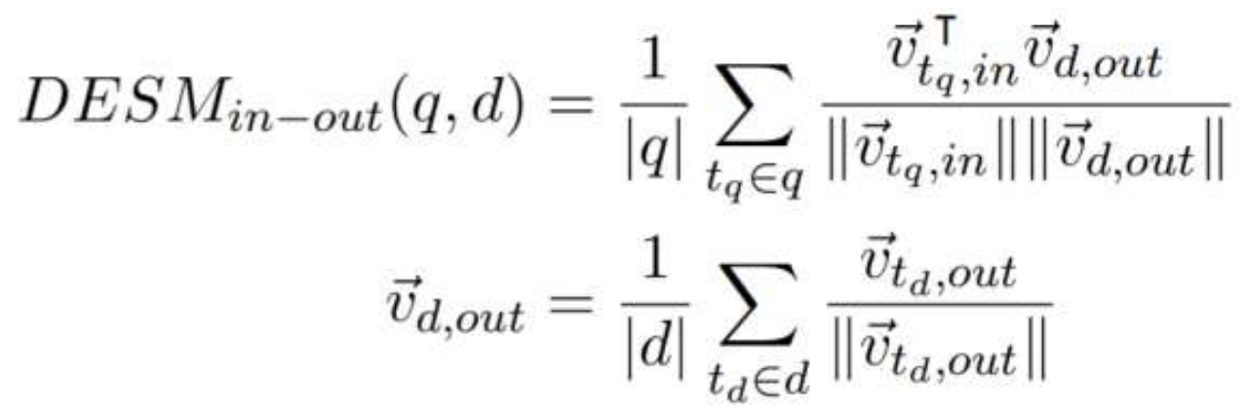
Dual Embedding Space Model
Average term embeddings model, but use IN embeddings for query terms and OUT embeddings for document terms
Eric Nalisnick, Bhaskar Mitra, Nick Craswell, and Rich Caruana. Improving document ranking with dual word embeddings. In WWW, 2016
Bhaskar Mitra, Eric Nalisnick, Nick Craswell, and Rich Caruana. A dual embedding space model for document ranking. arXiv preprint arXiv:1602.01137, 2016.

Slide 63
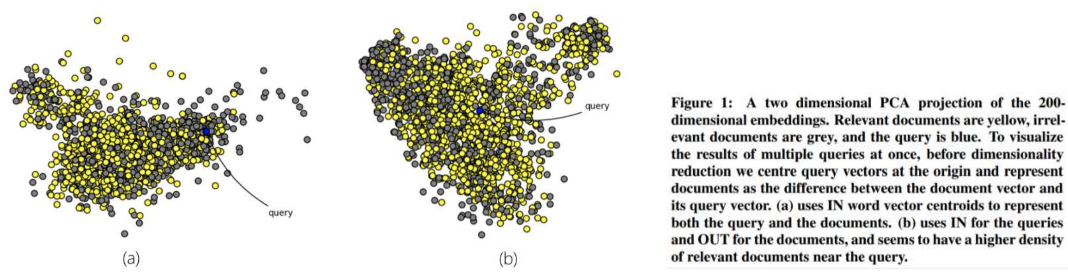
Dual Embedding Space Model
Eric Nalisnick, Bhaskar Mitra, Nick Craswell, and Rich Caruana. Improving document ranking with dual word embeddings. In WWW, 2016
Bhaskar Mitra, Eric Nalisnick, Nick Craswell, and Rich Caruana. A dual embedding space model for document ranking. arXiv preprint arXiv:1602.01137, 2016.

Slide 64
IN+OUT Embeddings for 2.7M words trained on 600M+ Bing queries
https://msropendata.com/datasets/30a504b0-cff2-4d4a-864f-3bc9a66f9d7e

Slide 65
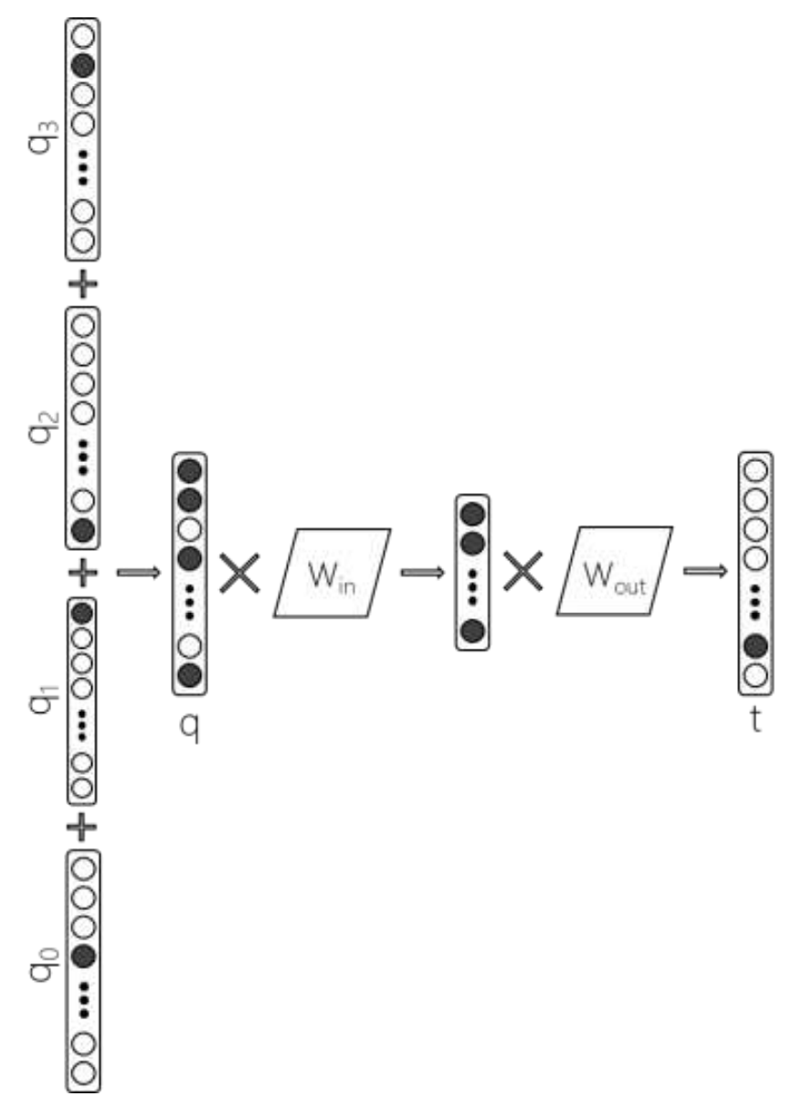
Relevance-based Word Embeddings
Goal: learn a word embedding that directly models a topical notion of similarity
Given query q, predict term t sampled from a smoothed language model (estimated using PRF) for the query
Hamed Zamani and W. Bruce Croft. Relevance-based word embedding. In SIGIR, 2017.

Slide 66
A Tale of 2 Queries
“PEKAROVIC LAND COMPANY”
Hard to learn good representation for the rare term pekarovic
But easy to estimate relevance based on count of exact term matches of pekarovic in the document
“WHAT CHANNEL ARE THE SEAHAWKS ON TODAY”
Target document likely contains ESPN or sky sports instead of channel
The terms ESPN and channel can be compared in a term embedding space
Matching in the term space is necessary to handle rare terms. Matching in the latent embedding space can provide additional evidence of relevance. Best performance is often achieved by combining matching in both vector spaces.

Slide 67
Incorporating Term Embedding for Matching
(1) Compare query and document directly in the embedding space
(2) Use embeddings to generate suitable query expansions
Notes:
(1)
Generalized Language Model [Ganguly et al., 2015]
Neural Translation Language Model [Zuccon et al., 2015]
Average term embeddings [Le and Mikolov, 2014, Nalisnick et al., 2016, Zamani and Croft, 2016, and others]
Word mover’s distance [Kusner et al., 2015, Guo et al., 2016]
(2)

Slide 68

Query Expansion Using Term Embeddings
Goal: Find good expansion terms based on nearness in the embedding space
Better retrieval performance when combined with pseudo-relevance feedback (PRF) [Zamani and Croft, 2016] and if we learn query specific term embeddings [Diaz et al., 2016]
(2) Use embeddings to generate suitable query expansions

Slide 69



“Word2vec is the sriracha sauce of deep learning! “
Christopher D. Manning

Slide 70

But a good chef would prepare the appropriate sauce for each dish

Slide 71

Global VS Local Embeddings
U_{global} - embedding trained with P(w|C)
U_{local} - embedding trained with P(w|R)
Where,
C is the whole document corpus
R is the set of relevant documents only

Slide 72

Query Expansion Using Global and Local Word Embeddings
Each point represents a candidate expansion term
Red points have high frequency in the relevant set of documents
White points have low or no frequency in the relevant set of documents
The blue point represents the query
Contours indicate distance from the query
Fernando Diaz, Bhaskar Mitra, and Nick Craswell. Query expansion with locally-trained word embeddings. In ACL, 2016

Slide 73
LUNCH
Time | Topic
9:00-9:10 | The Search Task
9:10-9:30 | Learning to Rank
9:30-10:30 | Embeddings
10:30-10:40 | Break
10:40-11:15 | Shallow Neural Methods for Ranking
11:15-12:15 | Lunch
12:15-13:45 | Deep Neural Methods for Ranking
13:45-14:00 | Break
14:00-15:00 | Skip-gram Exercise
15:00-16:00 | CBOW Exercise

Slide 74
Deep Neural Methods for Ranking
Time | Topic
9:00-9:10 | The Search Task
9:10-9:30 | Learning to Rank
9:30-10:30 | Embeddings
10:30-10:40 | Break
10:40-11:15 | Shallow Neural Methods for Ranking
11:15-12:15 | Lunch
12:15-13:45 | Deep Neural Methods for Ranking
13:45-14:00 | Break
14:00-15:00 | Skip-gram Exercise
15:00-16:00 | CBOW Exercise

Slide 75

Deep Semantic Similarity Model (DSSM)
Siamese network trained E2E on query and document title pairs
Relevance is estimated by cosine similarity between query and document embeddings
Input: character trigraph counts (bag of words assumption)
Minimizes cross-entropy loss against randomly sampled negative documents
Po-Sen Huang, Xiaodong He, Jianfeng Gao, Li Deng, Alex Acero, and Larry Heck. Learning deep structured semantic models for web search using clickthrough data. In CIKM, 2013.

Slide 76


Convolutional Deep Semantic Similarity Model (CDSSM)
Replace bag-of-words assumption by concatenating term vectors in a sequence on the input
Convolution followed by global max-pooling
Yelong Shen, Xiaodong He, Jianfeng Gao, Li Deng, and Gregoire Mesnil. A latent semantic model with convolutional-pooling structure for information retrieval. In CIKM, 2014.

Slide 77
Siamese Network

Slide 78


DSSM Tasks

Slide 79

DSSM Analogies Based on Query Pairs Training
Bhaskar Mitra. Exploring session context using distributed representations of queries and reformulations. In SIGIR, 2015.

Slide 80

Interaction-Based Networks (for short texts)
Typically a document is relevant if some part of the document contains information relevant to the query
Interaction matrix 𝑋—where 𝑥_{𝑖𝑗} is obtained by comparing the i^{th} window over query terms with the j^{th} window over the document terms - captures evidence of relevance from different parts of the document
Additional neural network layers can inspect the interaction matrix and aggregate the evidence to estimate overall relevance
Zhengdong Lu and Hang Li. A deep architecture for matching short texts. In NIPS, 2013.

Slide 81

Recap
…the important of incorporating exact term matches as well as matches in the latent space for estimating relevance?

Slide 82

Lexical and Semantic Matching Networks
Mitra et al. [2016] argue that both lexical and semantic matching is important for document ranking
Duet model is a linear combination of two DNNs—focusing on lexical and semantic matching, respectively—jointly trained on labelled data
Bhaskar Mitra, Fernando Diaz, and Nick Craswell. Learning to match using local and distributed representations of text for web search. In WWW, 2017.

Slide 83


Lexical and Semantic Matching Networks
Lexical sub-model operates over input matrix x
In relevant documents,
Many matches, typically in clusters
Matches localized early in document
Matches for all query terms
In-order (phrasal) matches
Bhaskar Mitra, Fernando Diaz, and Nick Craswell. Learning to match using local and distributed representations of text for web search. In WWW, 2017.

Slide 84

Lexical and Semantic Matching Networks
Convolve using window of size 𝑛_{𝑑} × 1
Each window instance compares a query term w/ whole document
Bhaskar Mitra, Fernando Diaz, and Nick Craswell. Learning to match using local and distributed representations of text for web search. In WWW, 2017.
Notes:
The order is taken into account here!

Slide 85

Lexical and Semantic Matching Networks
Semantic sub-model matches in the latent embedding space
Match query with moving windows over document
Learn text embeddings specifically for the task
Bhaskar Mitra, Fernando Diaz, and Nick Craswell. Learning to match using local and distributed representations of text for web search. In WWW, 2017.

Slide 86

Big VS Small Data Regimes
Big data seems to be more crucial for models that focus on good representation learning for text
Partial supervision strategies (e.g., unsupervised pre-training of word embeddings) can be effective but may be leaving the bigger gains on the table
Learning to train on unlabeled data may be key to making progress on neural ad-hoc retrieval
Bhaskar Mitra, Fernando Diaz, and Nick Craswell. Learning to match using local and distributed representations of text for web search. In WWW, 2017.

Slide 87
Duet implementation on PyTorch:
https://github.com/bmitra-msft/NDRM/blob/master/notebooks/Duet.ipynb

Slide 88

Wide and Deep Model
Deep model for representation learning and wide model for memorization
Heng-Tze Cheng, Levent Koc, Jeremiah Harmsen, Tal Shaked, et al. Wide & deep learning for recommender systems. In workshop on deep learning for recommender systems, 2016.

Slide 89

Web Documents Are More Than Just Body Text …

Slide 90

Extending Neural Ranking Models to Multiple Document Fields
Learn a different embedding space for each document field
Different fields may match different aspects of the query - learn different query embeddings for matching against different fields
Represent per field match by a vector, not a score
Field level dropout during training can regularize against over-dependency on any individual field
Hamed Zamani, Bhaskar Mitra, Xia Song, Nick Craswell, and Saurabh Tiwary. Neural ranking models with multiple document fields. In WSDM, 2018.
Notes:
Handmard – element-wise product

Slide 91

Many Other Neural Architectures

Slide 92

BERT for Ranking
BERT (and other large-scale unsupervised language models) are demonstrating dramatic performance improvements on many IR tasks
Rodrigo Nogueira, and Kyunghyun Cho. Passage Re-ranking with BERT. In arXiv, 2019.

Slide 93


BERT for Ranking
Impact across both academia and industry

